Slide 1
Social Story – LEP School Programs
A social story can help students, especially autistic students, with expectations for participating in your program including what to bring, what they'll be doing and who will be with them. This can assist to lower anxiety about participating in something new. This should be shared in PowerPoint format to ensure schools can adapt to their students' needs.
Instructions:
Update relevant sections based on your school offering – select ‘show comments’ to see LSV’s suggestions. Drag and drop images or replace with your own relevant images wherever possible to ensure accurate representations are shared with students. Delete any unused images.
Update any highlighted text and remove highlighting. Delete this slide before sharing. Delete comments directed to ‘Partners’ before sharing.

Slide 2
Social Story – LEP School Programs
LSV and ** have developed this Social Story to use ahead of your school’s Lifesaving education program for any student that may benefit. A social story can help students, especially autistic students, with expectations for participating in your program including what to bring, what they'll be doing and who will be with them. This can assist to lower anxiety about participating in something new.
Please review against your proposed program and update as required – i.e., select ‘see comments’ to check activities against your selected program type, or you may have elected to participate in some activities and not others, you may also like to add in other aspects about getting to the program and which school staff will be available.
If you would prefer a cartoon version, please get in touch.

Slide 3
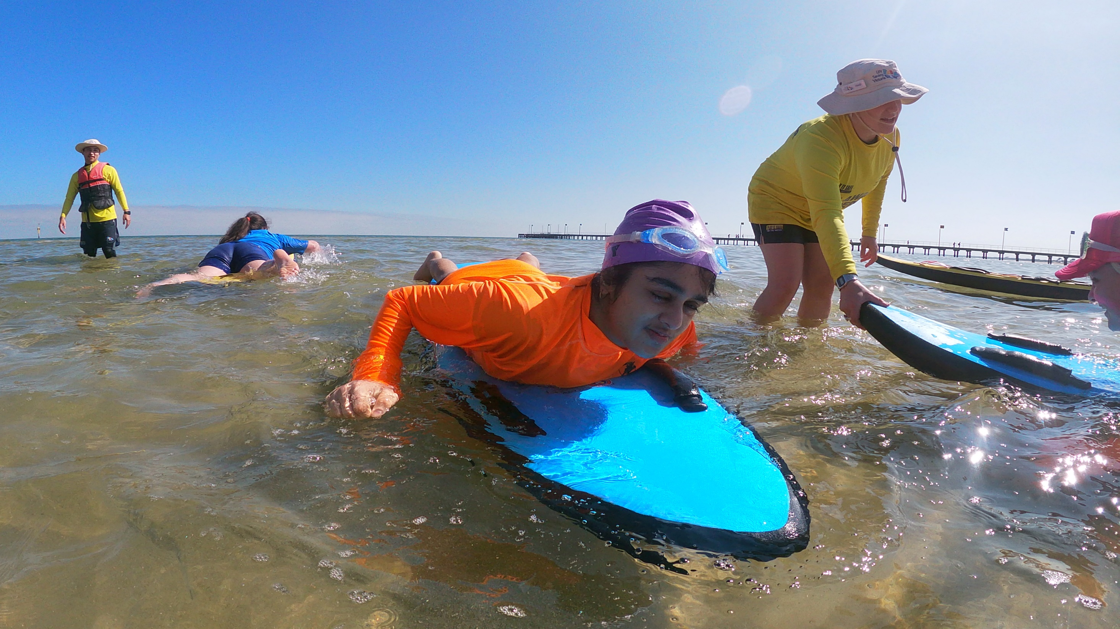
Social story: What happens at a Lifesaving education programs
Lifesaving Education Programs

Slide 4
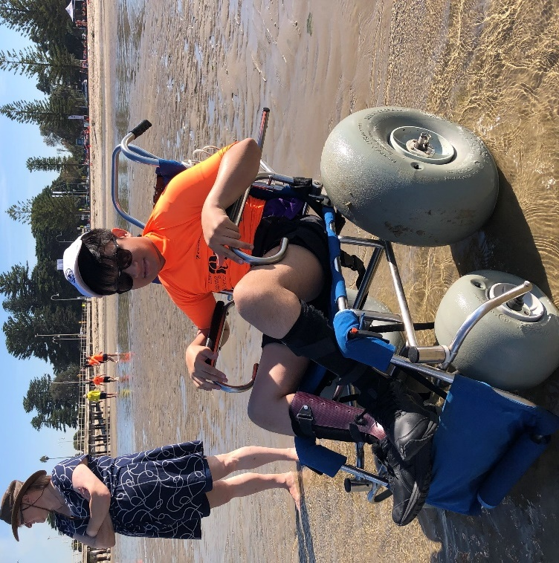
Read this social story before and after participating in the beach program.
We hope you have lots of fun trying the different activities.

Slide 5

Life Saving Victoria acknowledges the Traditional Owners of the land and water where we meet.
We pay our respects to Elders past, present and emerging.
Lifesaving Education Programs

Slide 6
XXXX
acknowledges the Traditional Owners of the land and water where we deliver the Lifesaving education programs, the XXXX.
We pay our respects to Elders past, present and emerging.

Slide 7
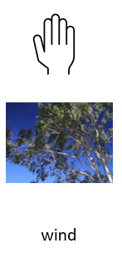

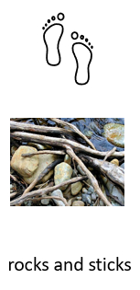
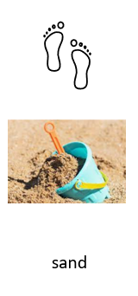
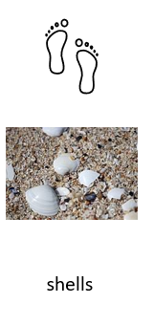

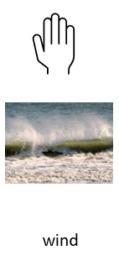




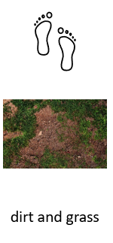
At the river/lake/pool/beach, we might experience:

Slide 8

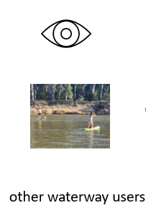


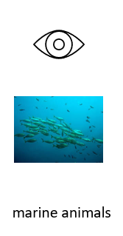
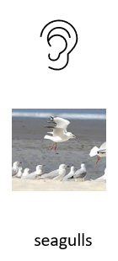
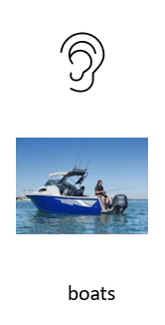

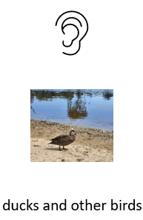
At the river/lake/pool/beach, we might experience:

Slide 9
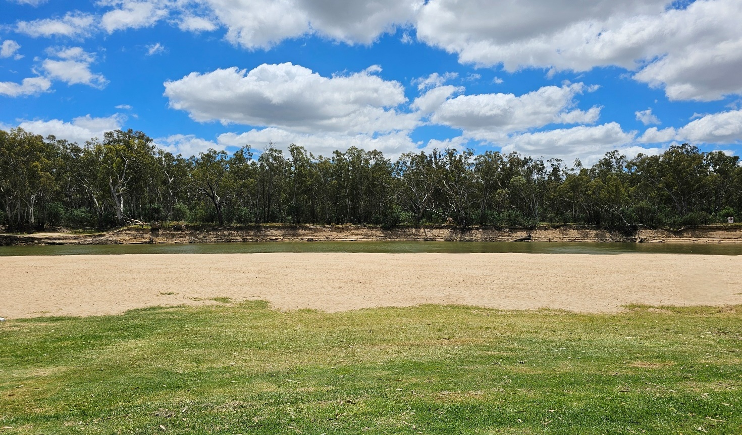
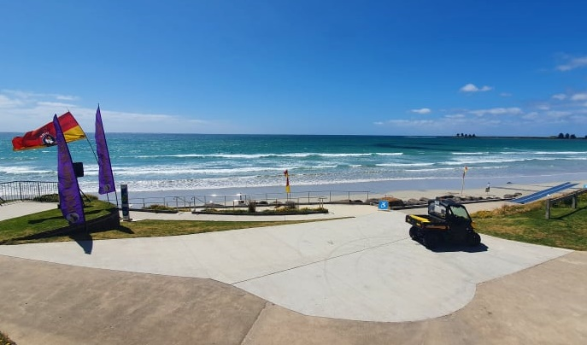
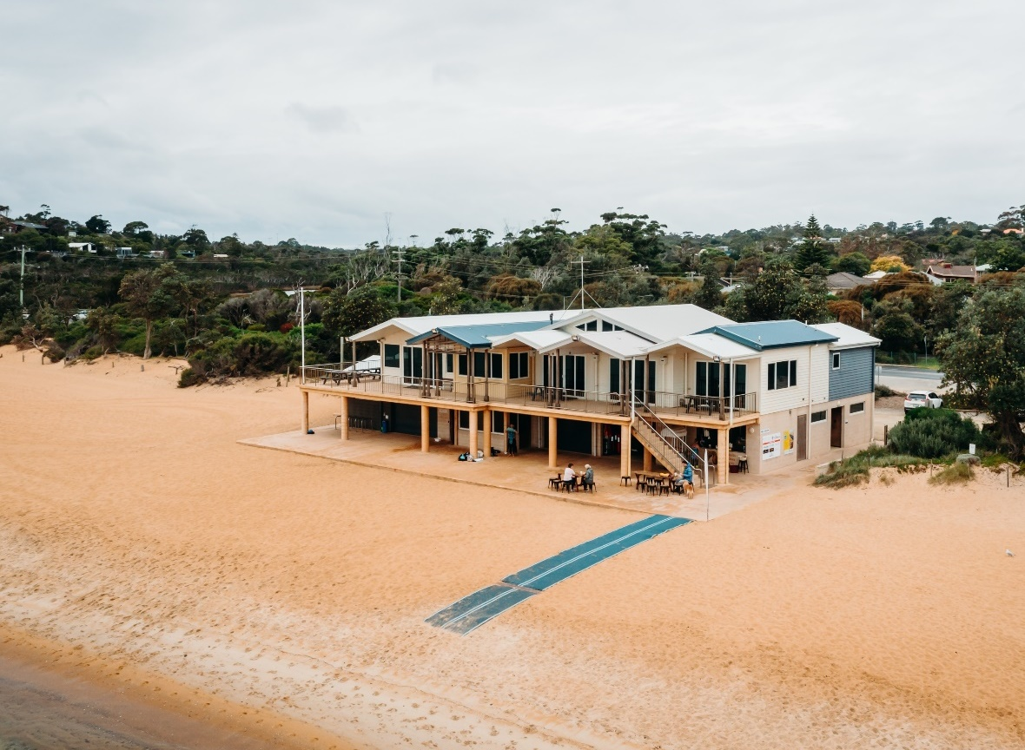
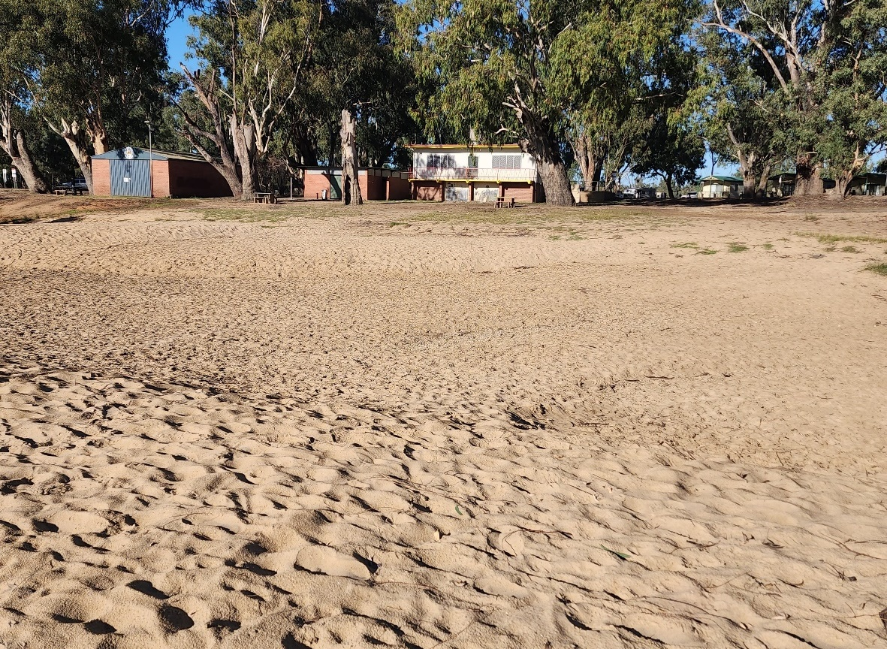
We arrive at the river/lake/pool/beach

Slide 10
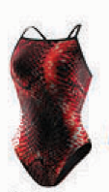
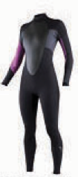
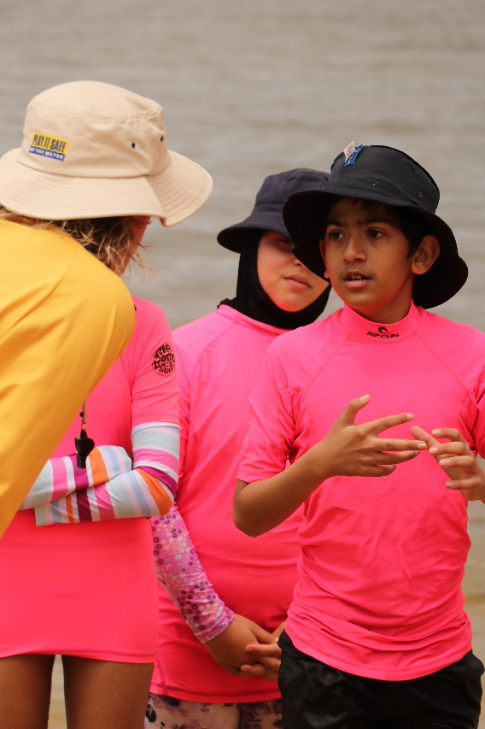
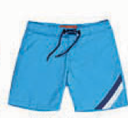
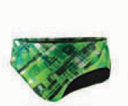
Don’t forget to wear your bathers. You will be given a bright rash top to wear in the water.

Slide 11
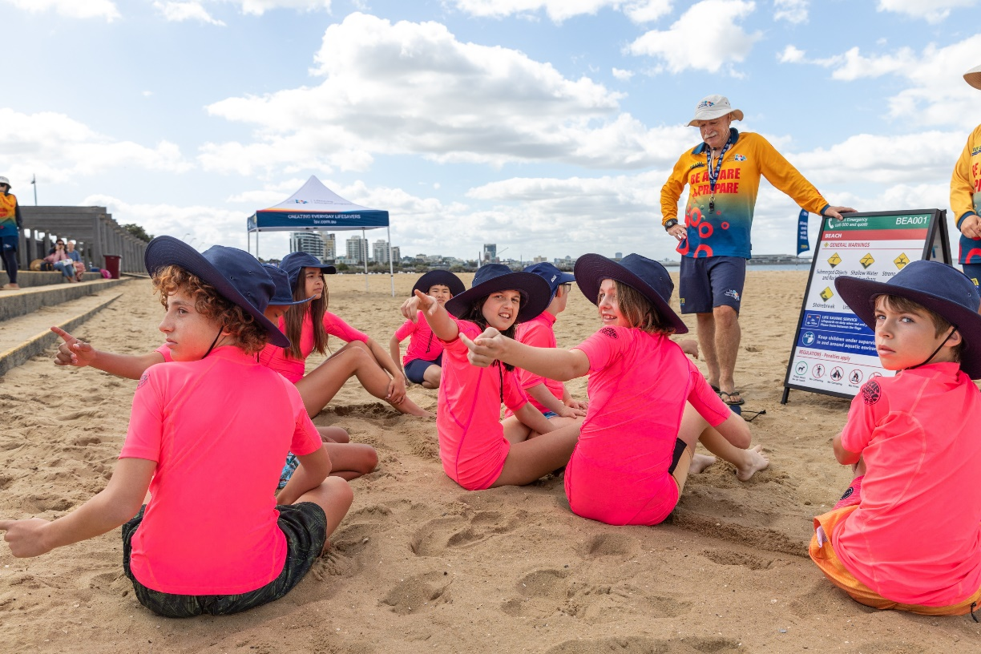
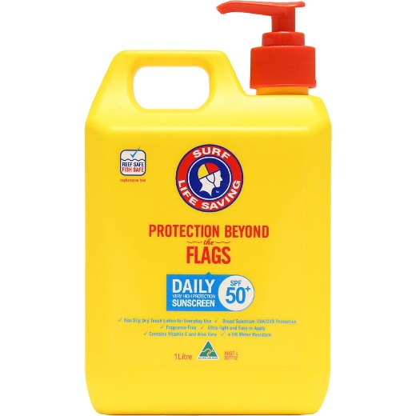
Don’t forget to wear a SunSmart hat and put on sunscreen.

Slide 12
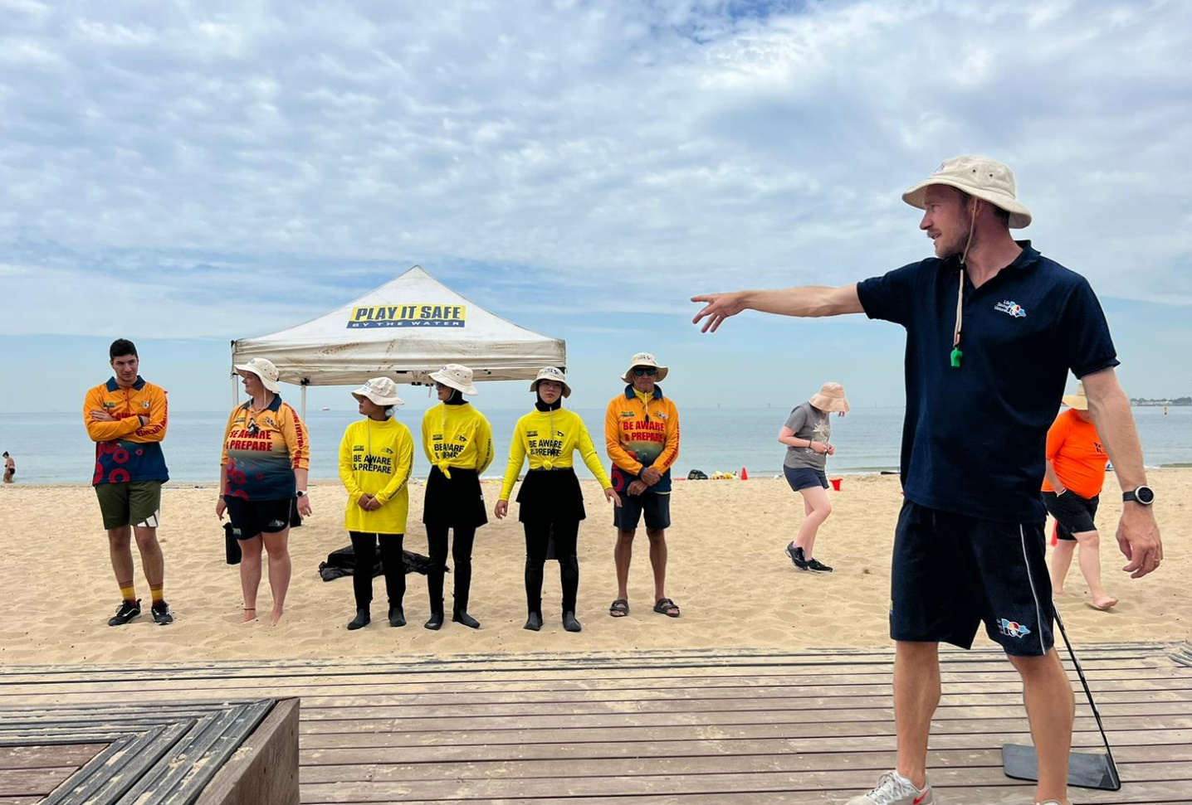
We meet the team of instructors, and these are their uniforms

Slide 13
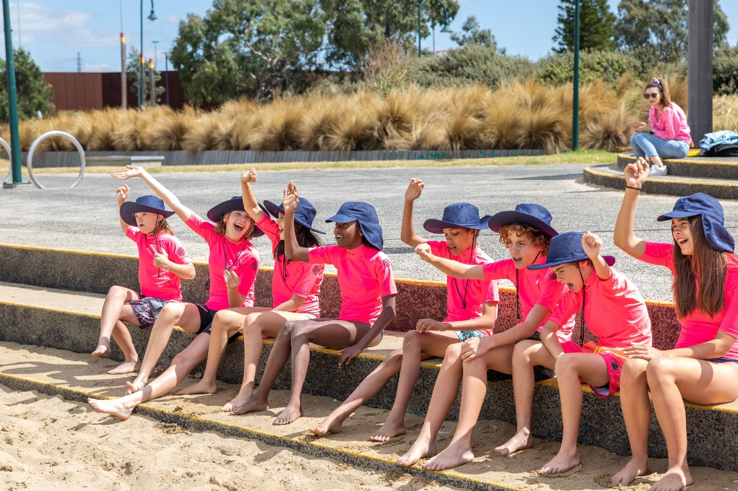
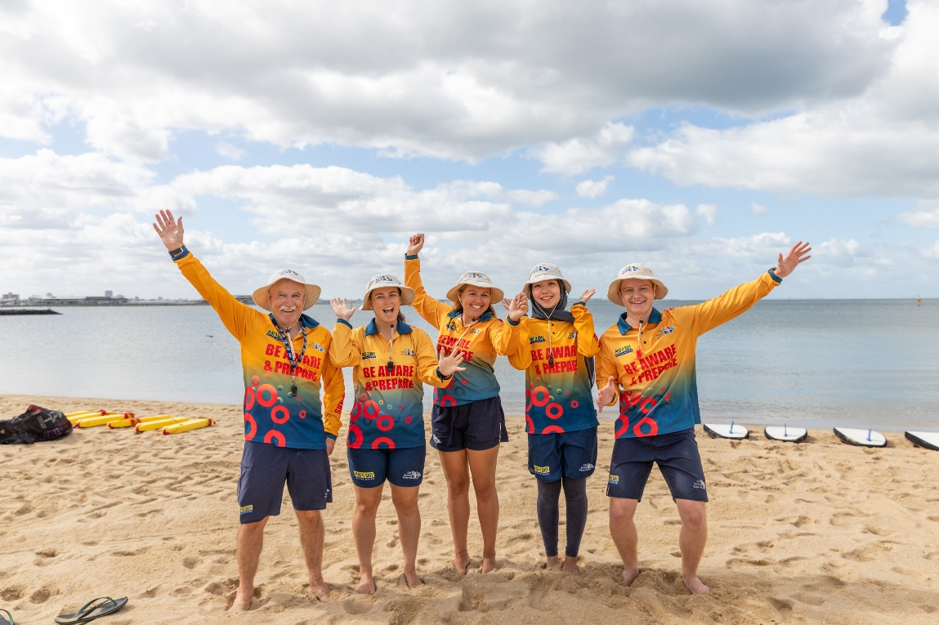
If you need help, raise your hand and look for one of our instructors or your teacher

Slide 14
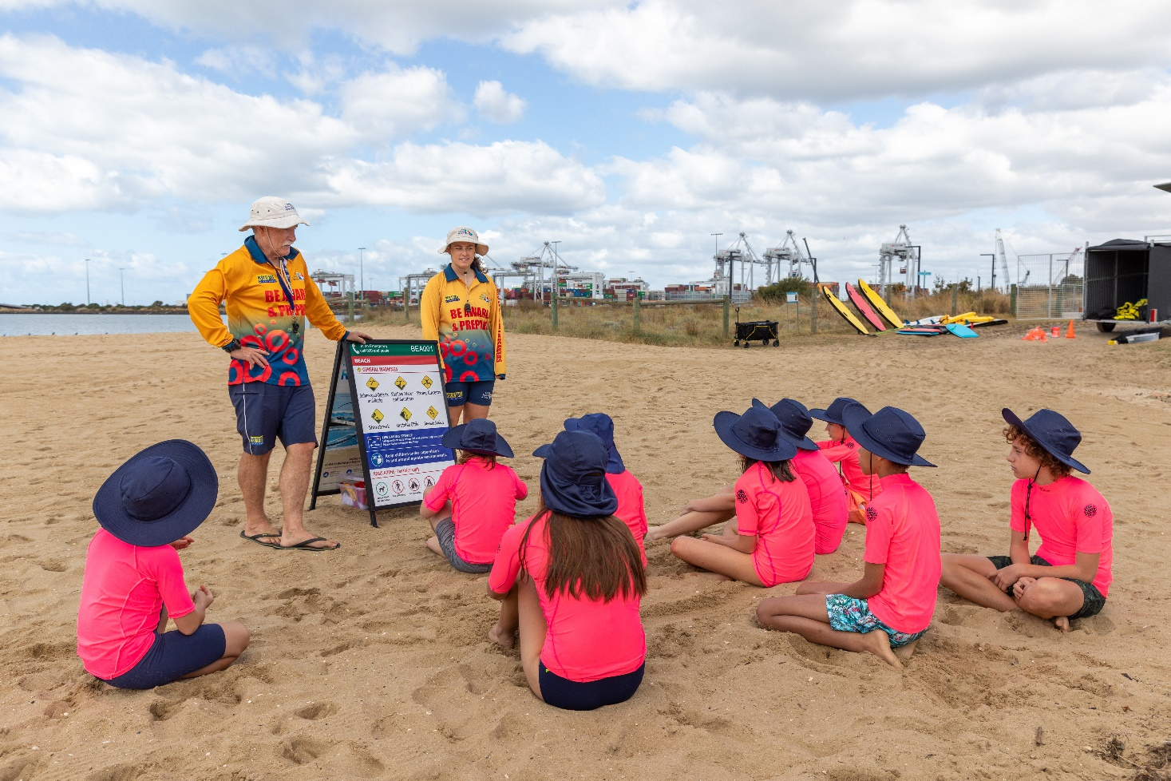
We learn about the rules and safety

Slide 15
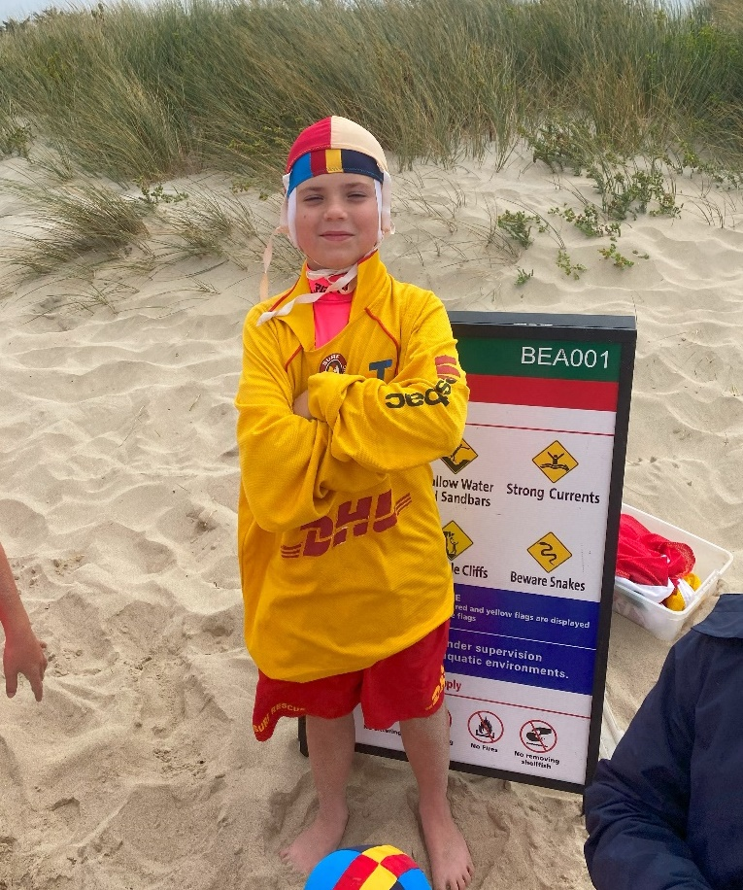
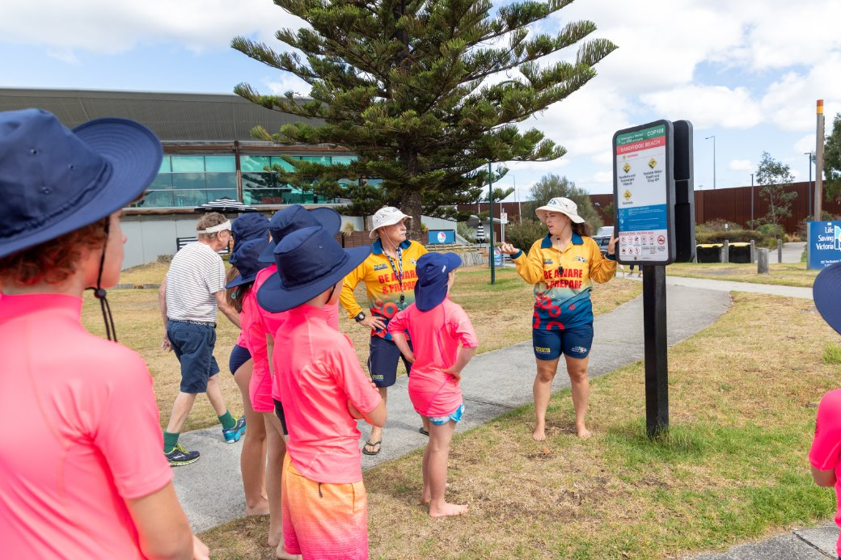
We will talk about how to be safe around water

Slide 16
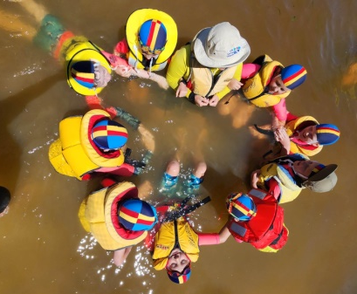
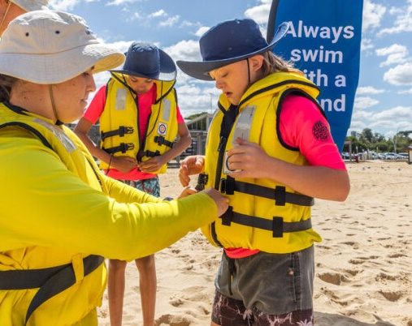
Activities will include wearing life jackets in the water

Slide 17
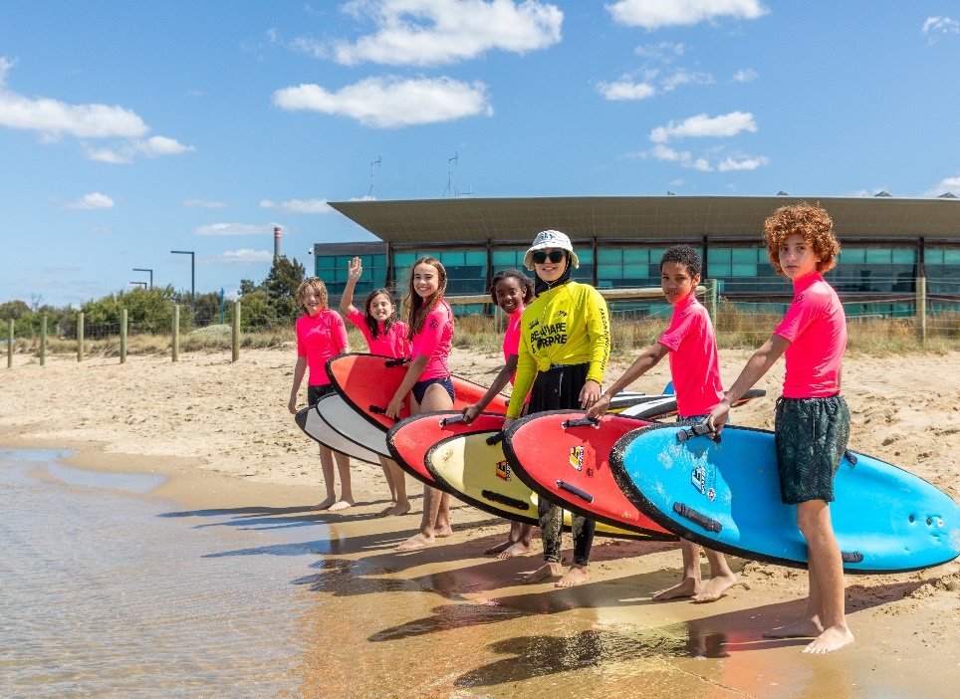
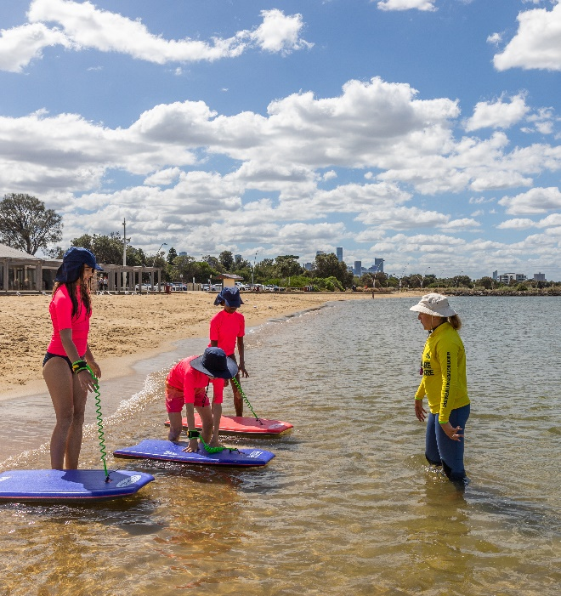
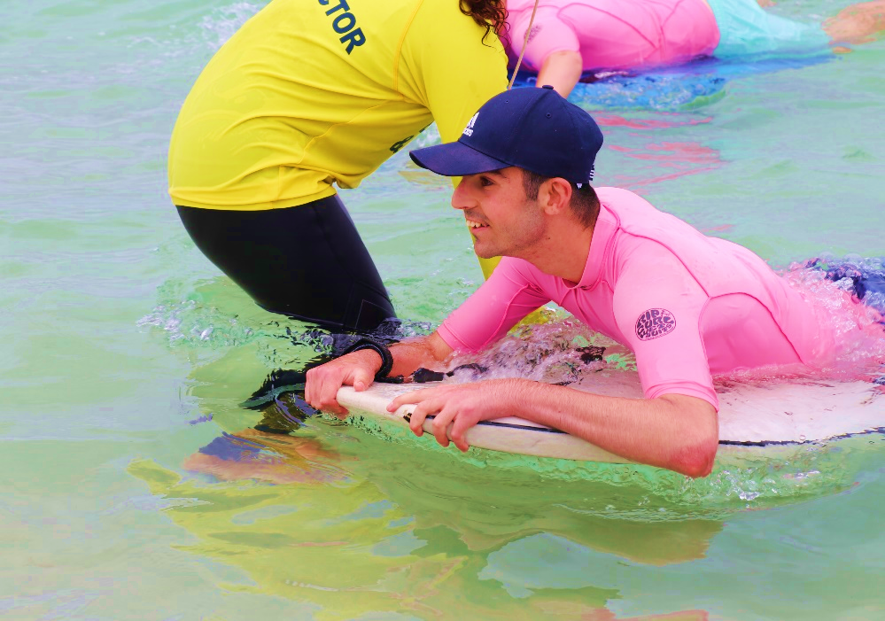
Activities will include paddling on boards

Slide 18
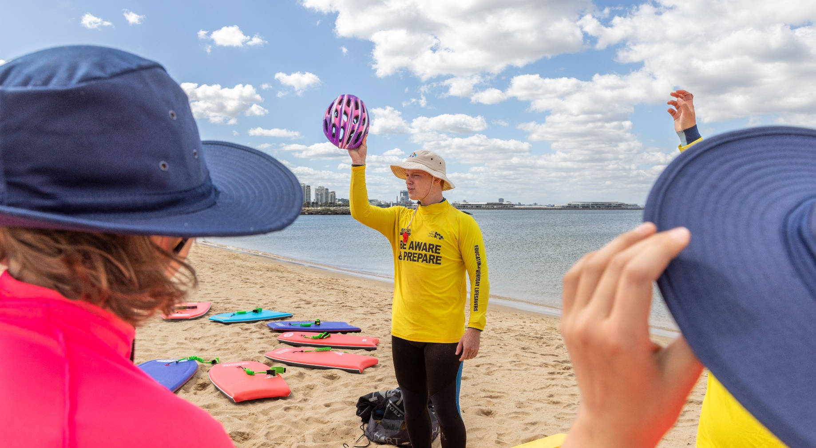
We will talk about how to rescue someone

Slide 19
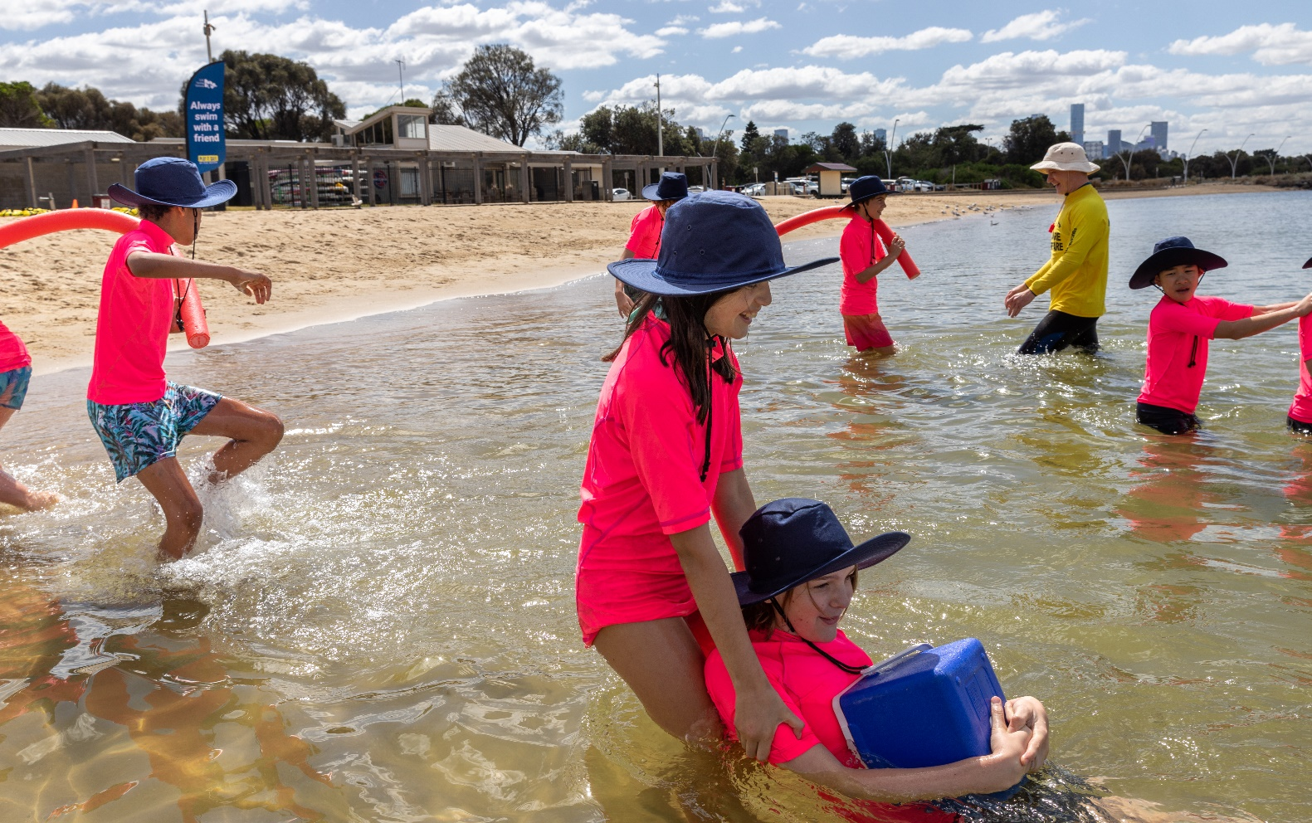
We will practise rescuing each other

Slide 20
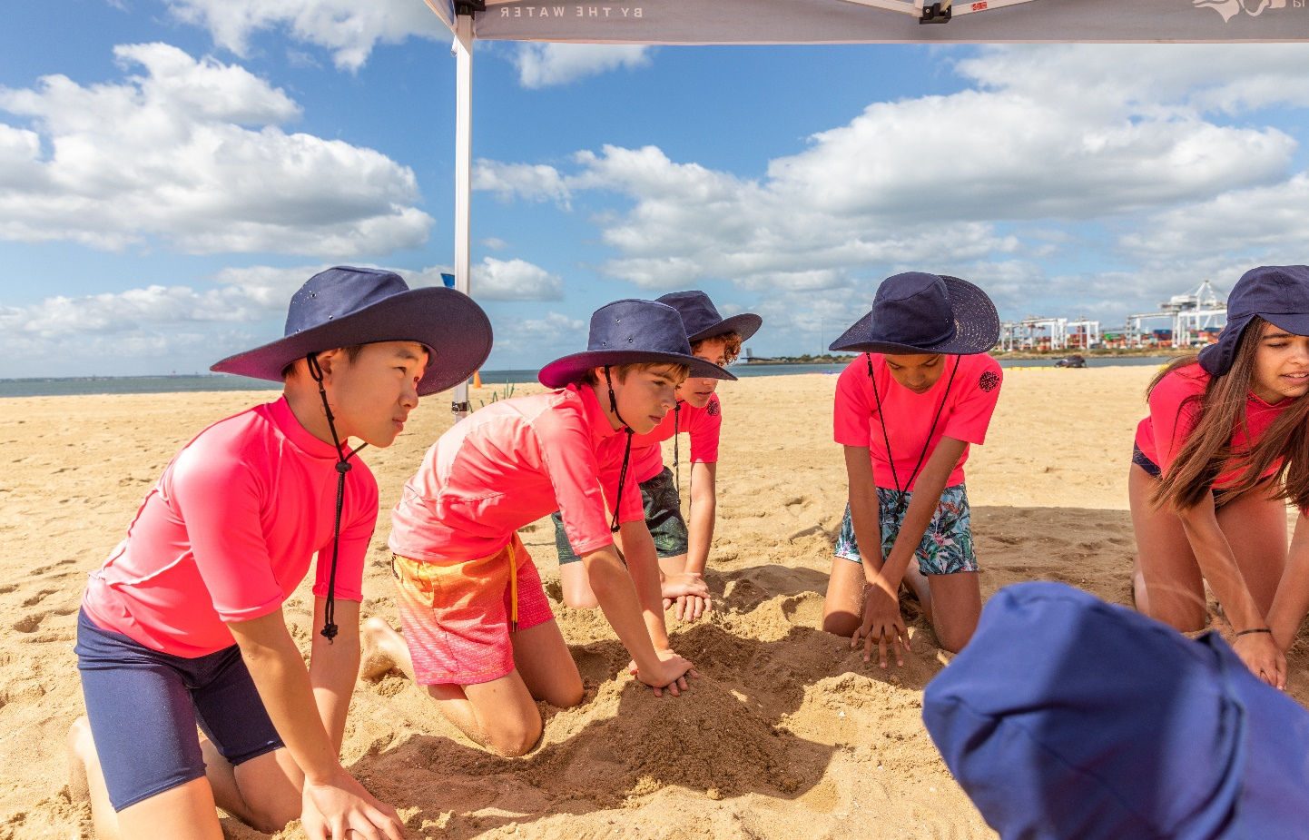
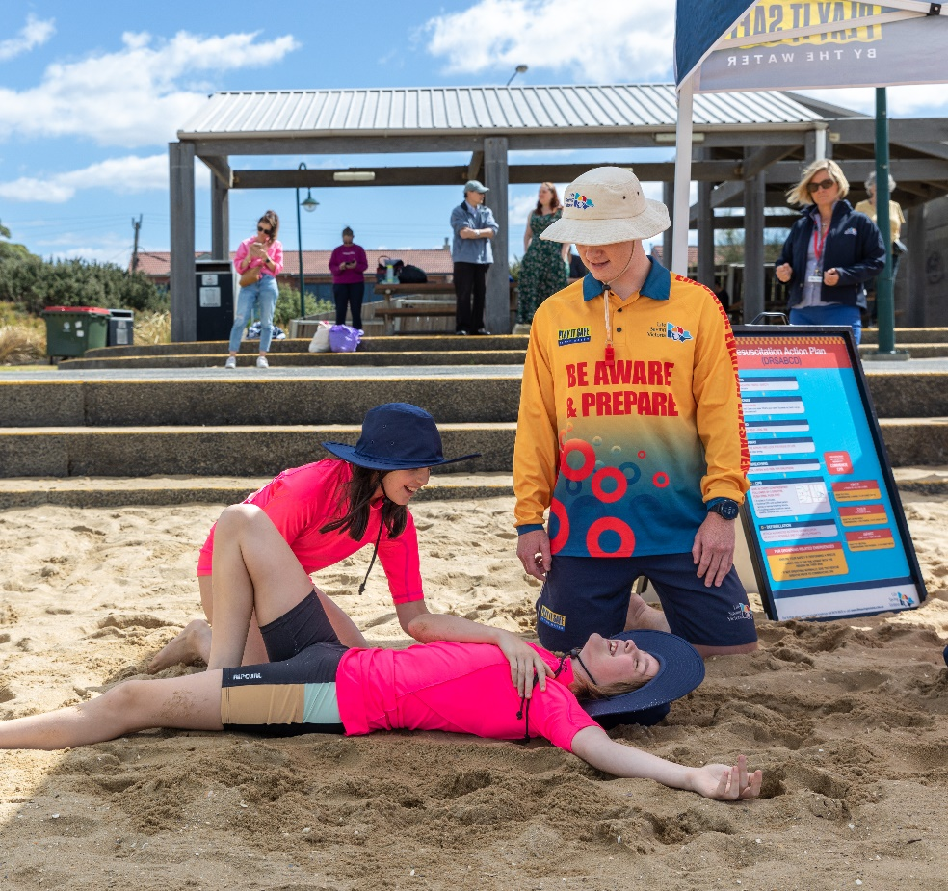
We will practice what to do in an emergency

Slide 21
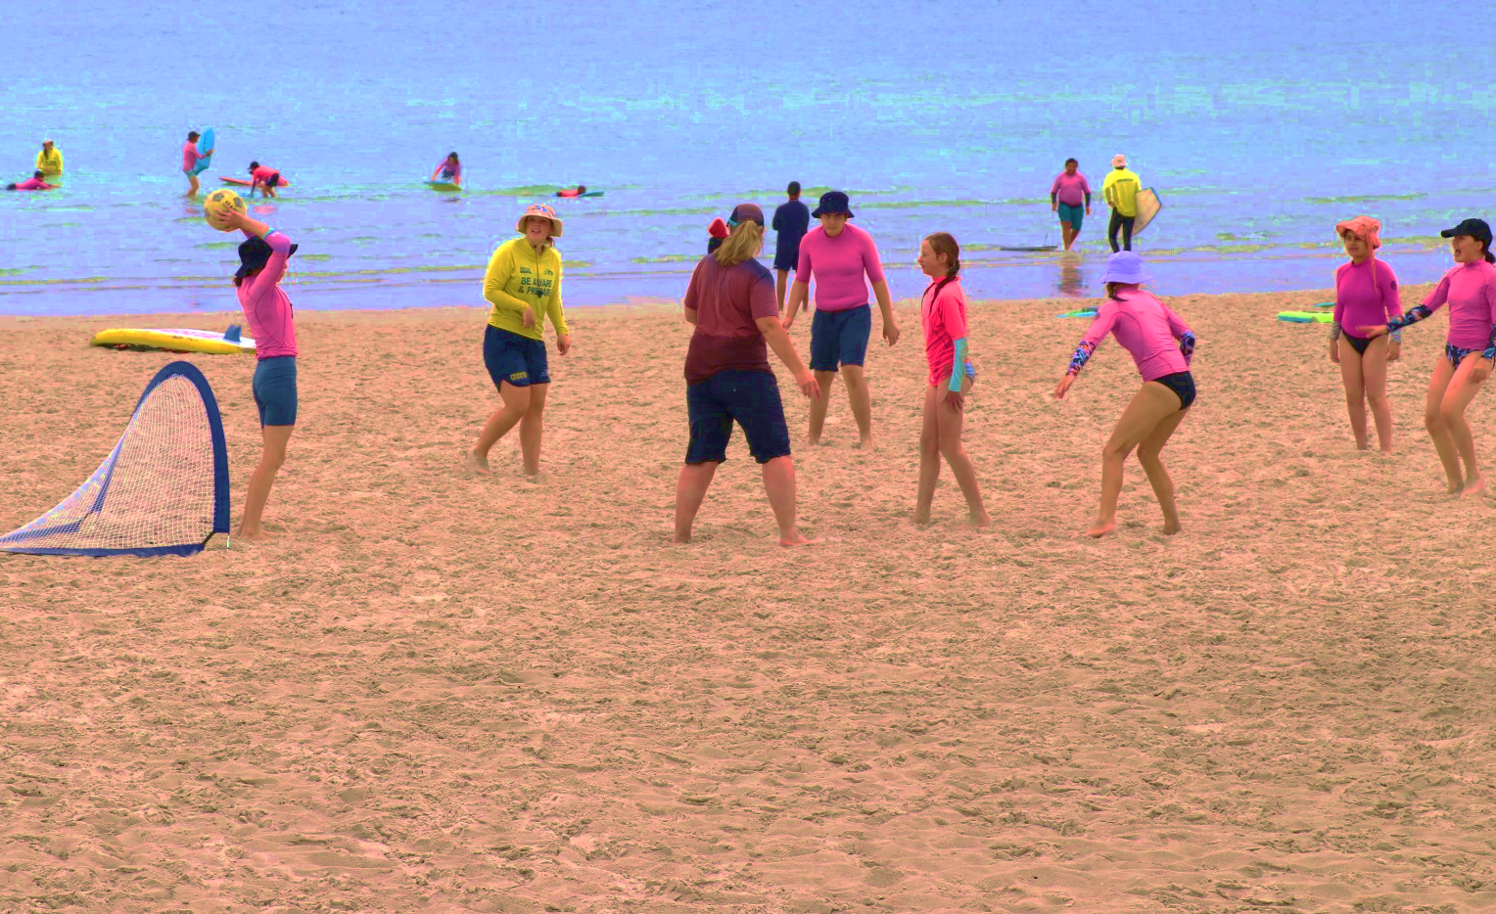

We will play beach games on the beach

Slide 22
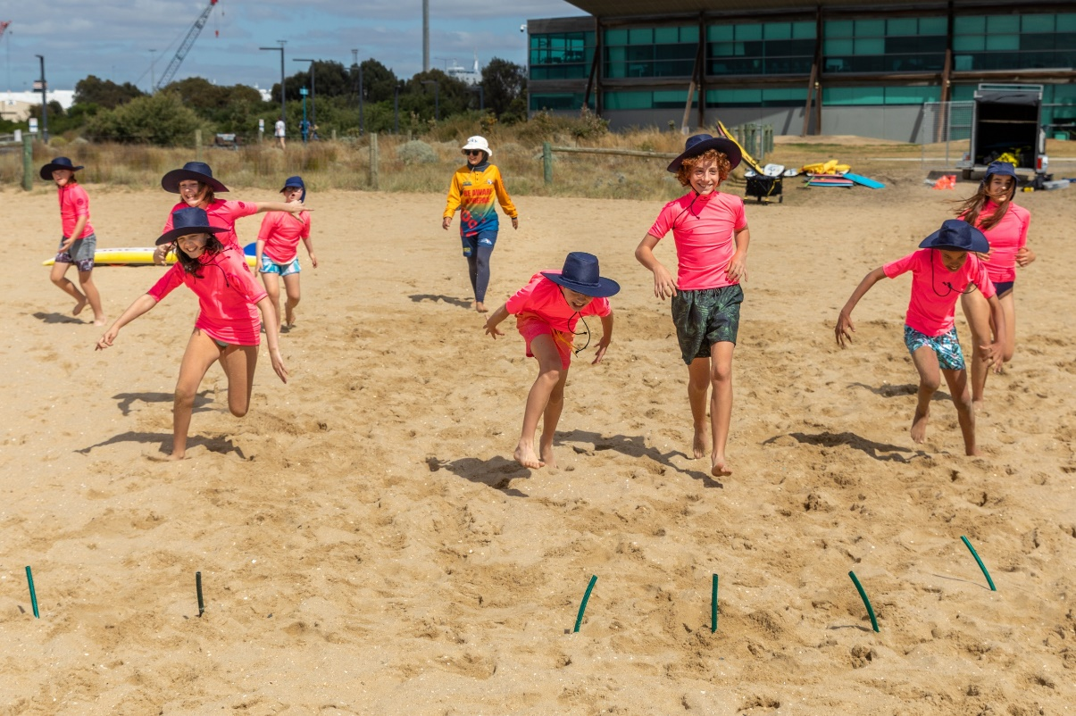
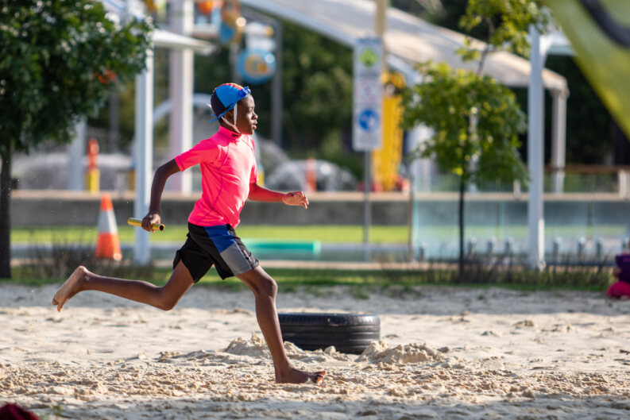
We will practice running games

Slide 23
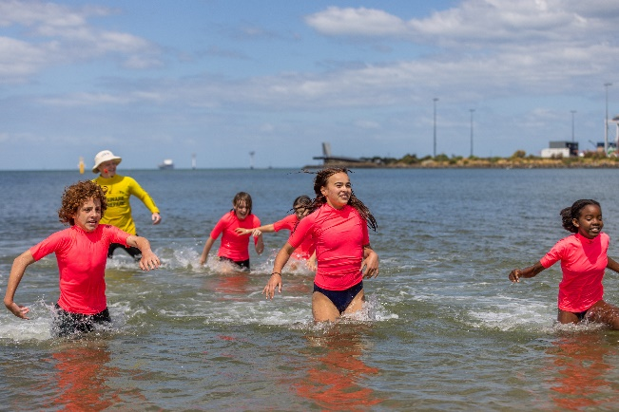
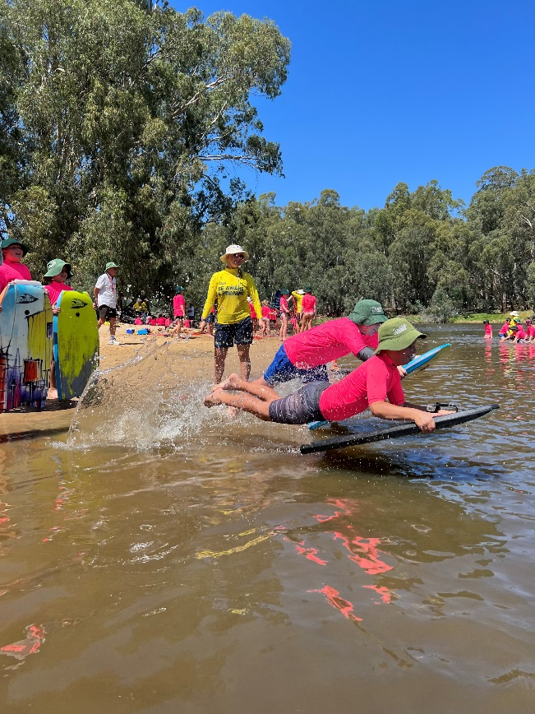
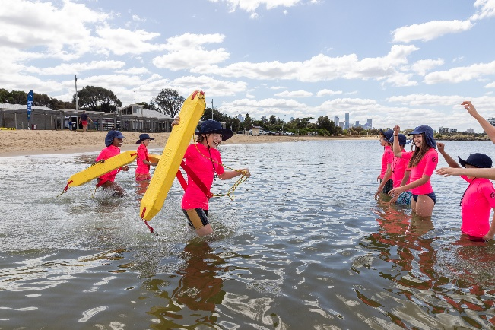
We will do races and relays with boards, life jackets and rescue equipment

Slide 24
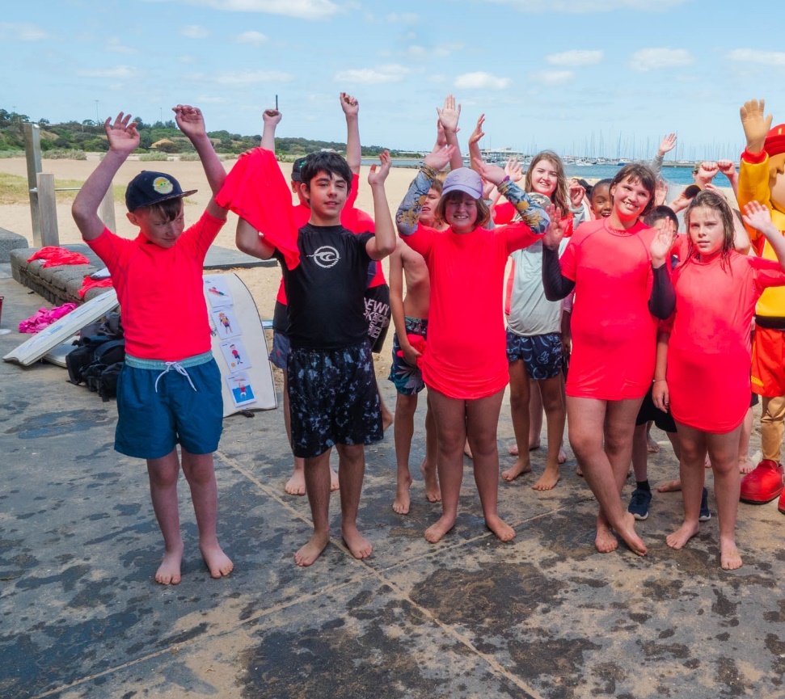
Now the program ends, and we say goodbye

