Slide 1
Social Story – LEP Bush Nippers
A social story can help students, especially autistic students, with expectations for participating in your program including what to bring, what they'll be doing and who will be with them. This can assist to lower anxiety about participating in something new. This should be shared in PowerPoint format to ensure schools can adapt to their students' needs.
Instructions:
Update relevant sections based on your school offering – select ‘show comments’ to see LSV’s suggestions. Drag and drop images or replace with your own relevant images wherever possible to ensure accurate representations are shared with students. Delete any unused images.
Update any highlighted text and remove highlighting. Delete this slide before sharing. Delete comments directed to ‘Partners’ before sharing.

Slide 2
Social Story – LEP Bush Nippers
LSV and ** have developed this Social Story to use ahead of your participant's Lifesaving education program for any child that may benefit. A social story can help participants, especially autistic children, with expectations for participating in your program including what to bring, what they'll be doing and who will be with them. This can assist to lower anxiety about participating in something new.
Please review and update as required – i.e.,you may also like to add in other aspects about getting to the program and which adult/s will be available.
If you would prefer a cartoon version, please get in touch.

Slide 3
Social story: What happens at a Lifesaving Education Program – Bush Nippers
Lifesaving Education Programs

Slide 4
Read this social story before and after participating in the program.
We hope you have lots of fun trying the different activities.

Slide 5
Life Saving Victoria acknowledges the Traditional Owners of the land and water where we meet.
We pay our respects to Elders past, present and emerging.

Slide 6
XXXX
acknowledges the Traditional Owners of the land and water where we deliver the Lifesaving education programs, the XXXX.
We pay our respects to Elders past, present and emerging.

Slide 7
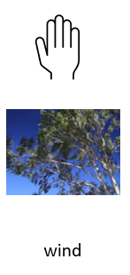
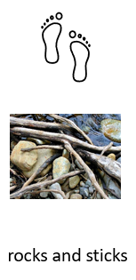
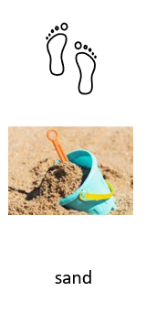
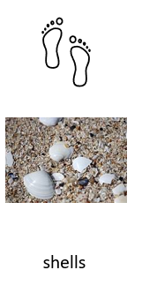
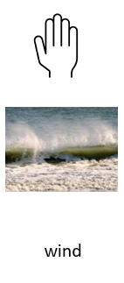
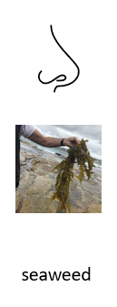
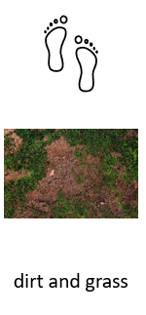
At the river/lake/pool/beach, we might experience:

Slide 8
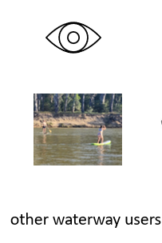
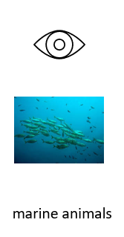
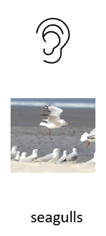
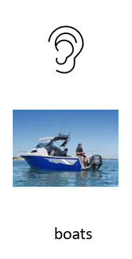
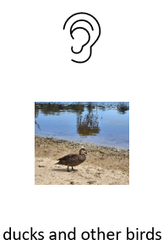
At the river/lake/pool/beach, we might experience:

Slide 9
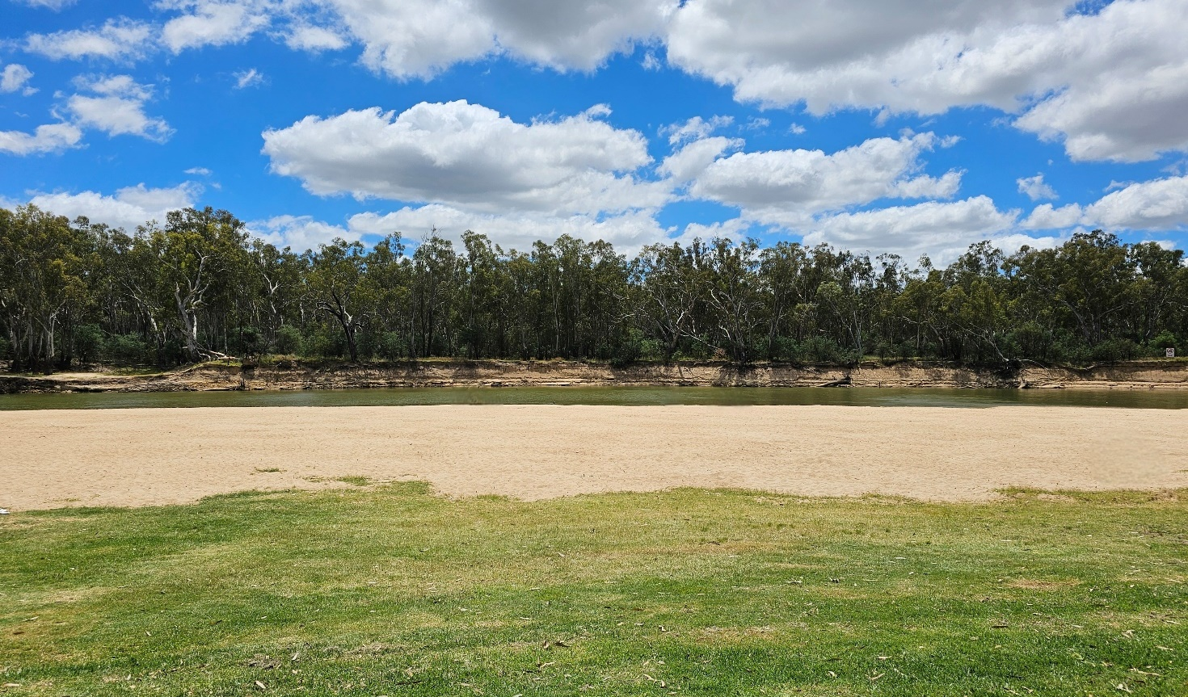
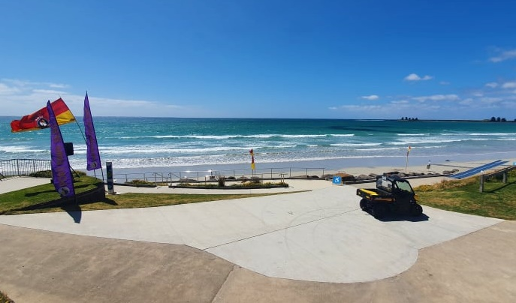
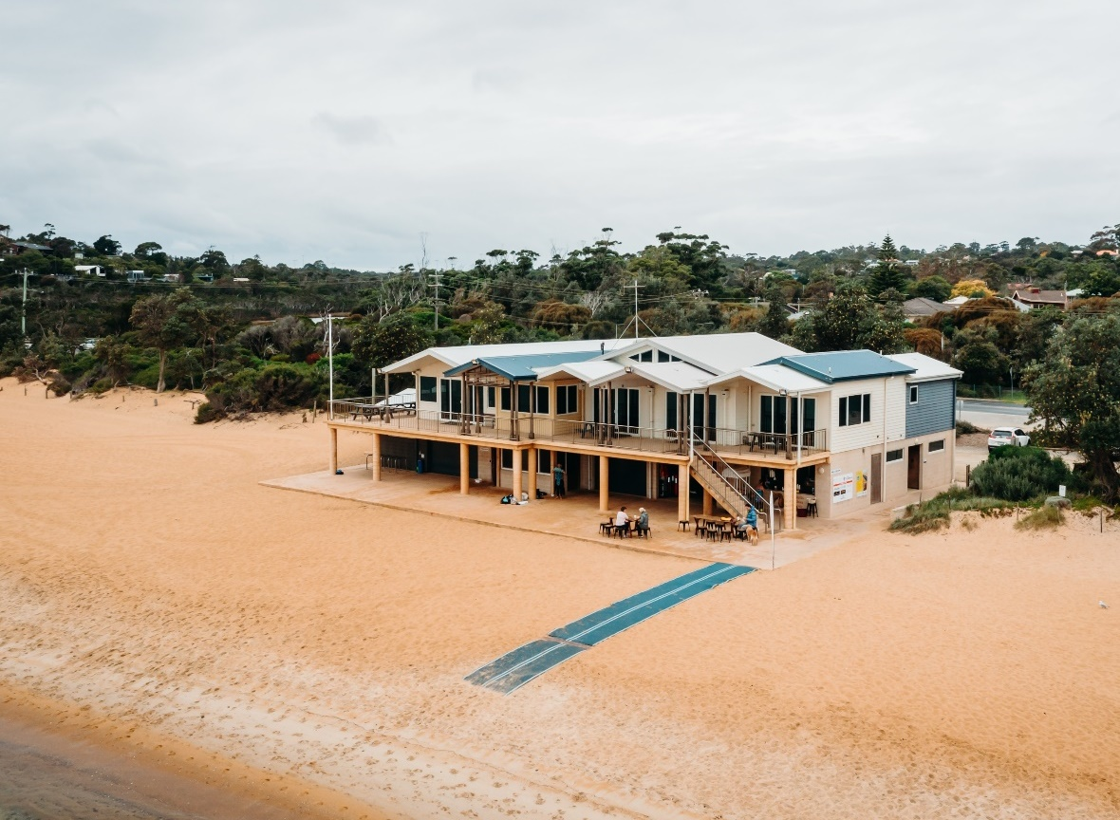
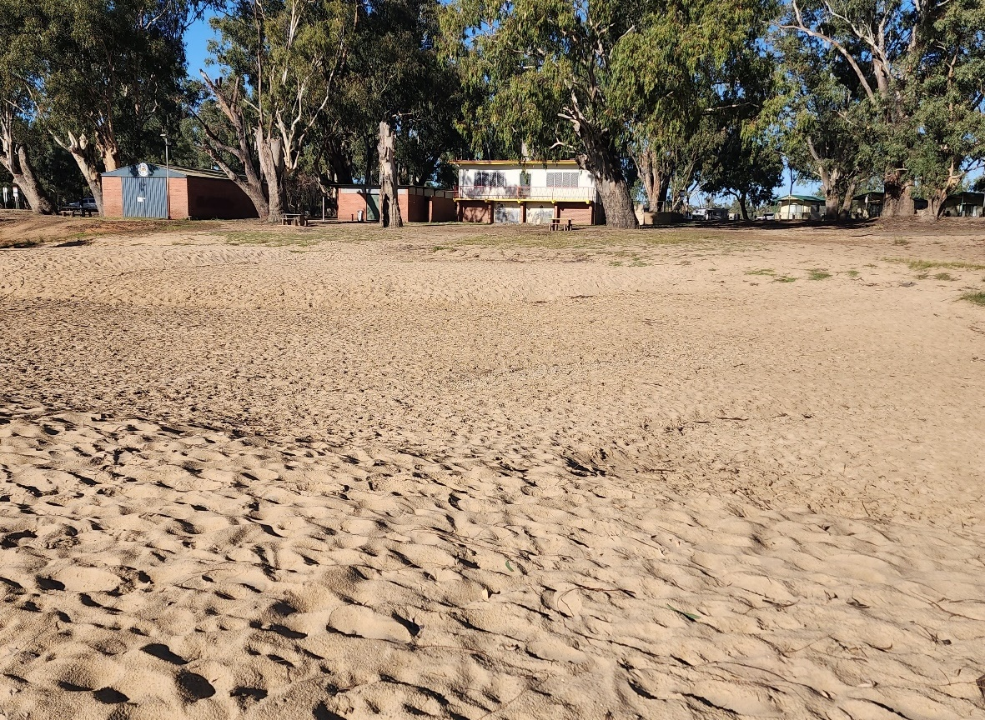
We arrive at the river/lake/pool/beach

Slide 10
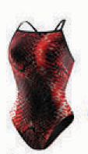
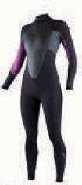
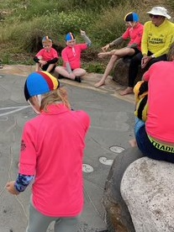
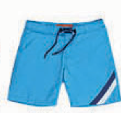
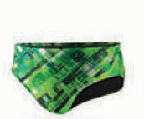
Don’t forget to wear your bathers and you will be given a bright rash top and nipper cap to wear in the water.

Slide 11
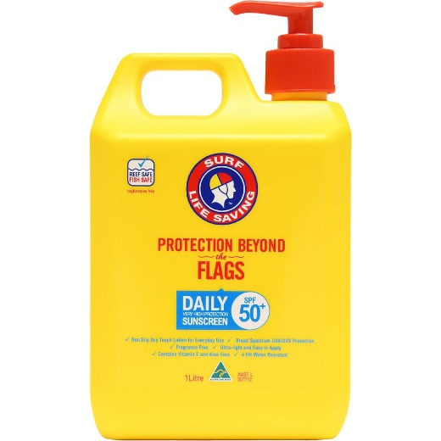
Don’t forget to wear a SunSmart hat and put on sunscreen.

Slide 12
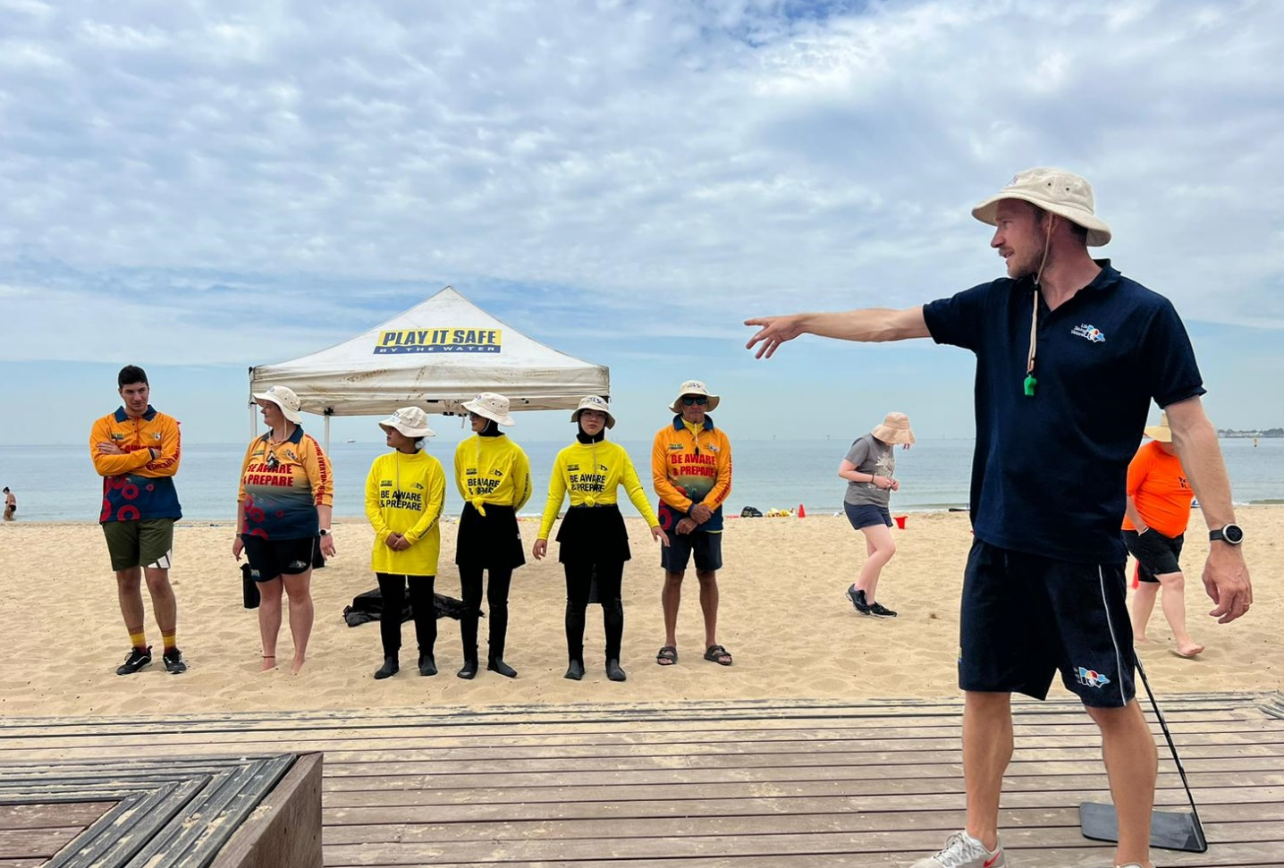
We meet the team of instructors, and these are their uniforms

Slide 13
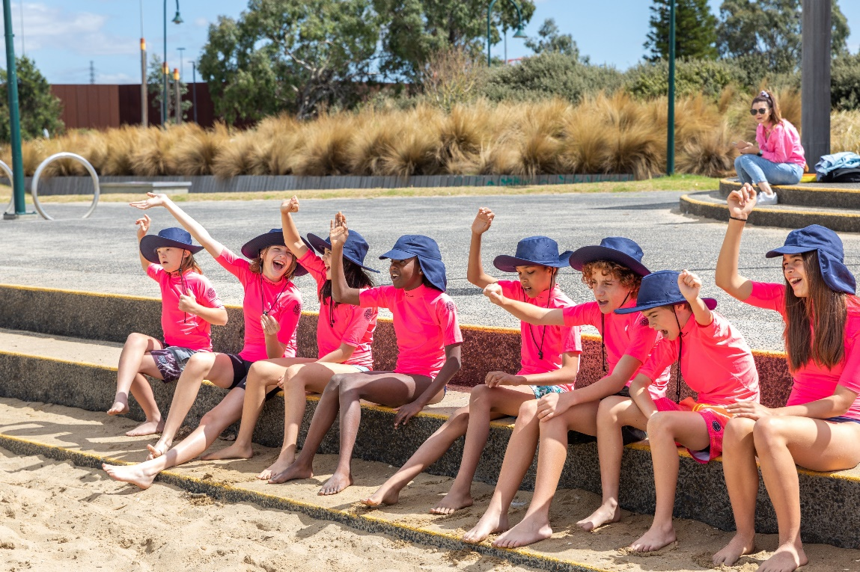
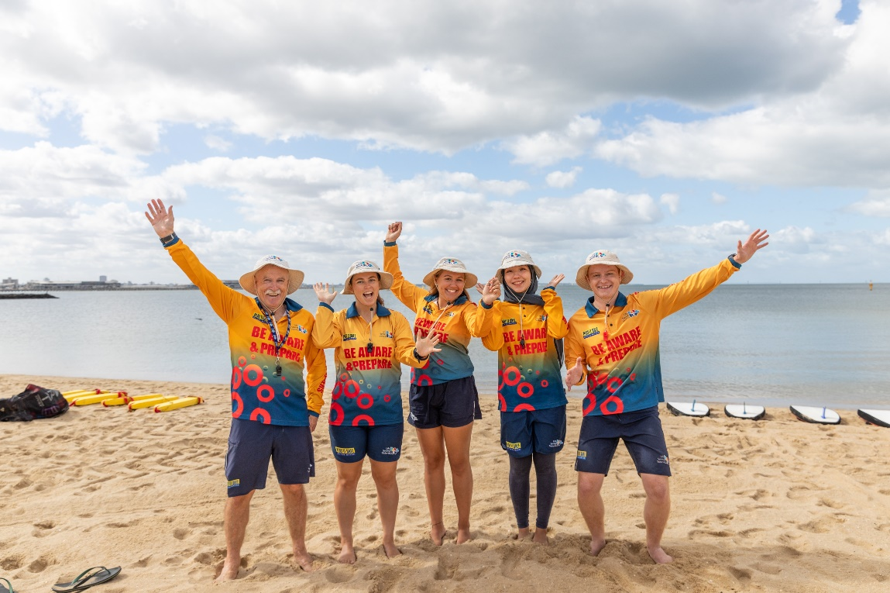
If you need help, raise your hand and look for one of our instructors or your teacher

Slide 14
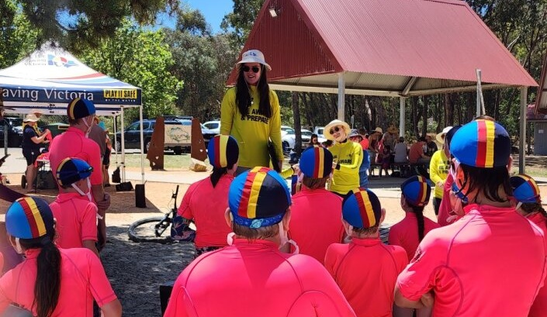
We learn about the rules and safety

Slide 15
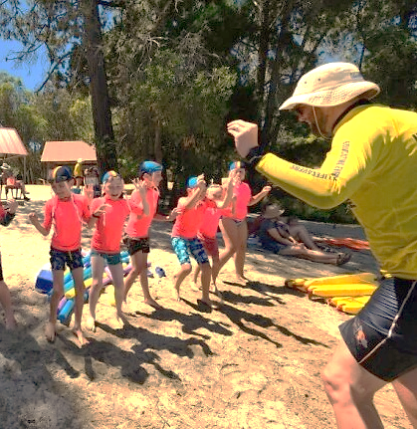
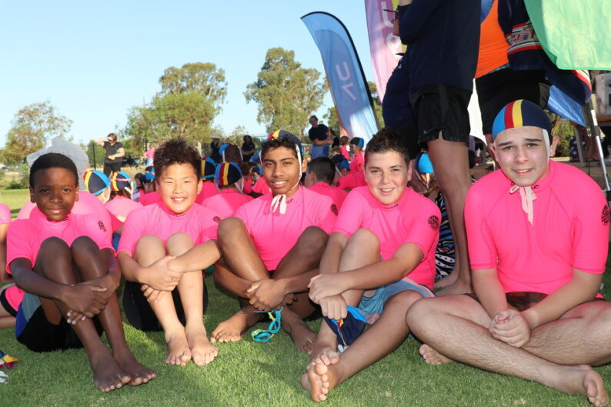
We will play some games in smaller groups to get to know each other’s names.

Slide 16
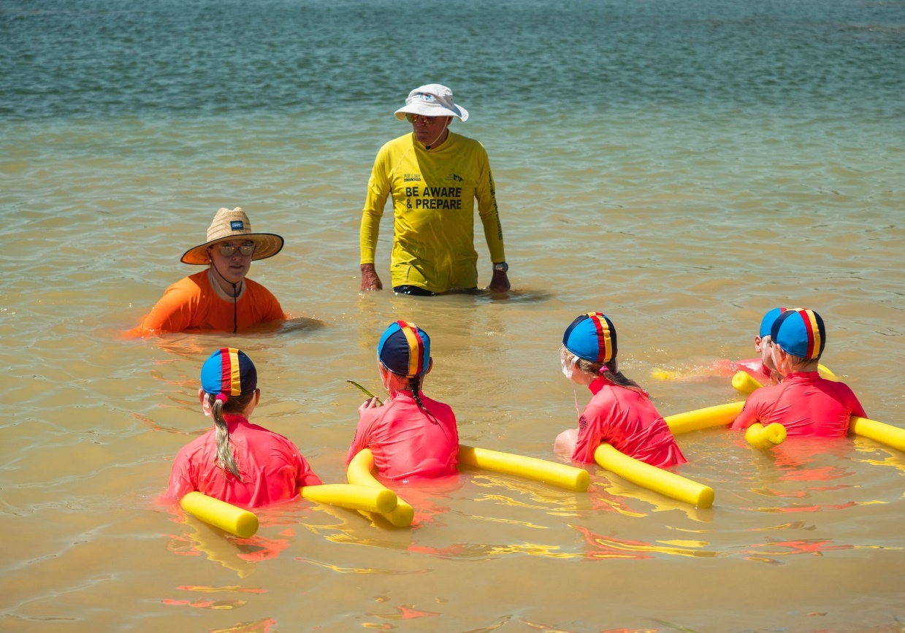
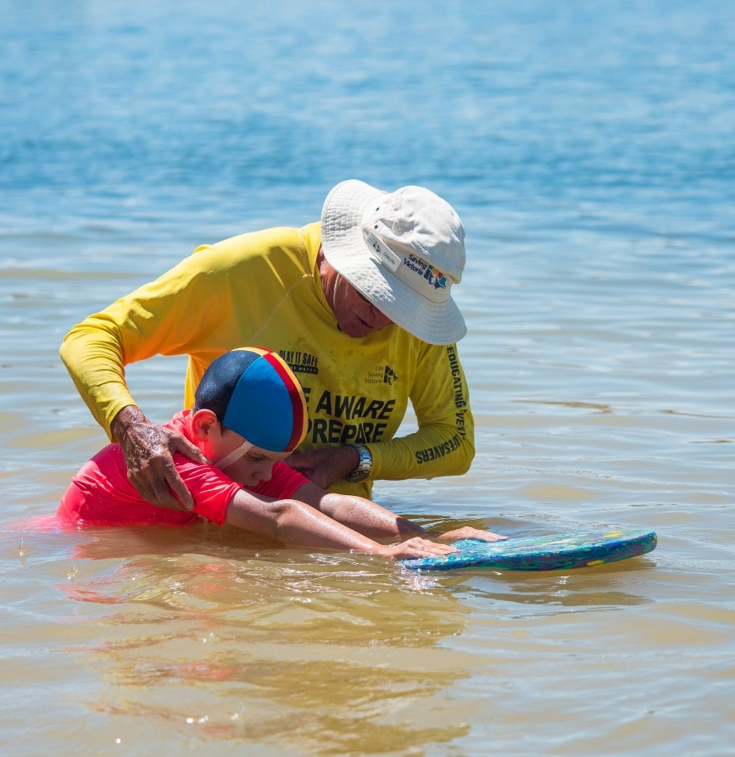
We will practice our swimming skills and feeling comfortable in the water.

Slide 17
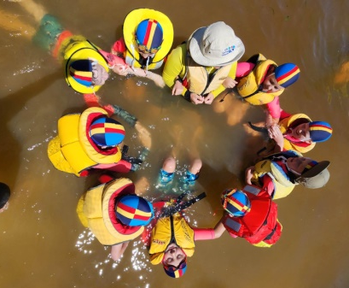
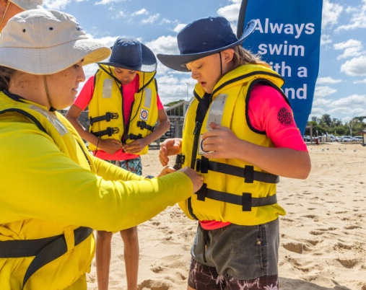
Activities will include wearing life jackets in the water

Slide 18
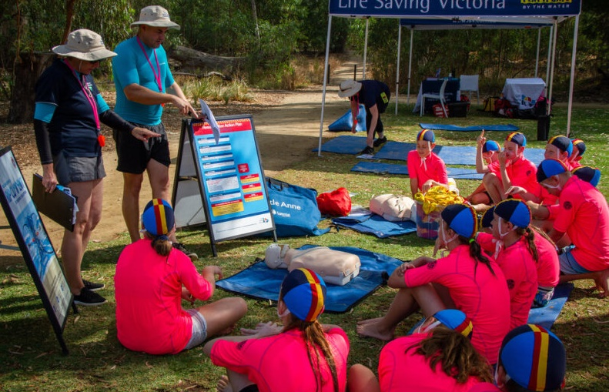
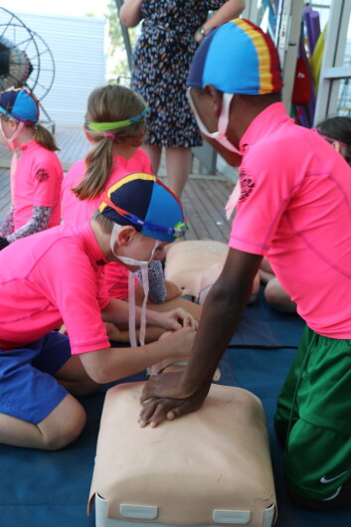
We will practice what to do in an emergency

Slide 19
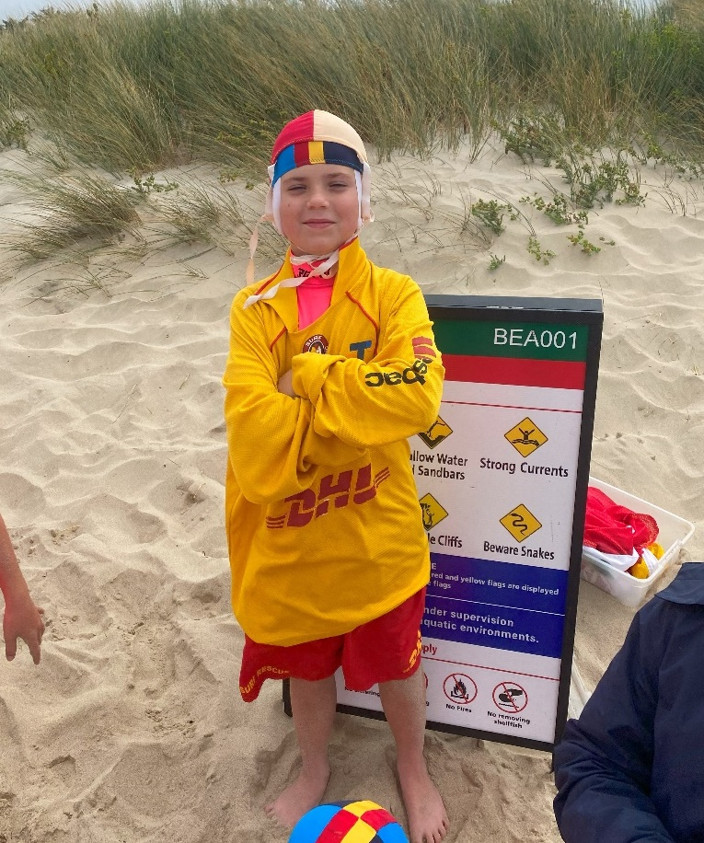
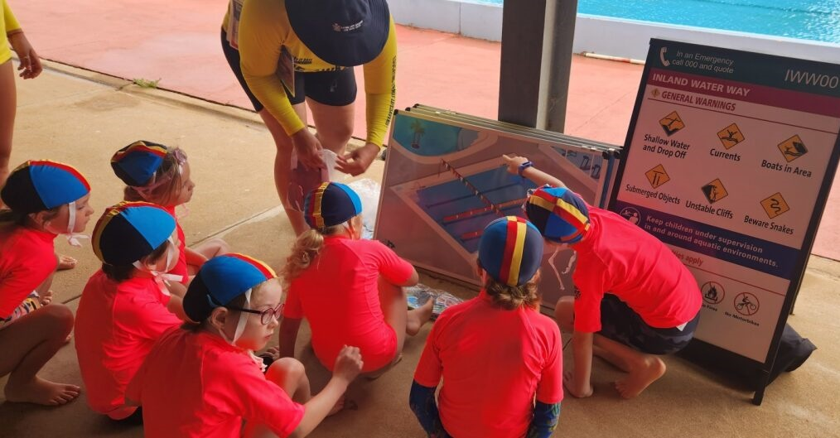
We will talk about how to be safe around water

Slide 20
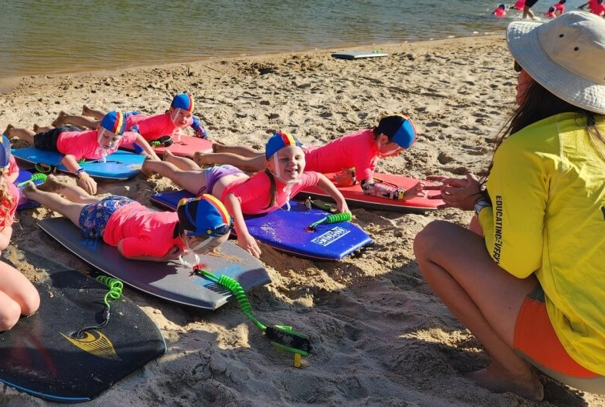
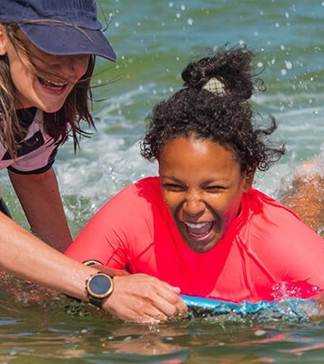
Activities will include paddling on boards

Slide 21
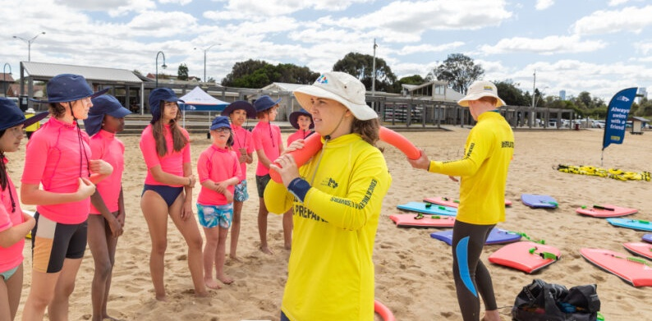
We will talk about and demonstrate how to rescue someone

Slide 22
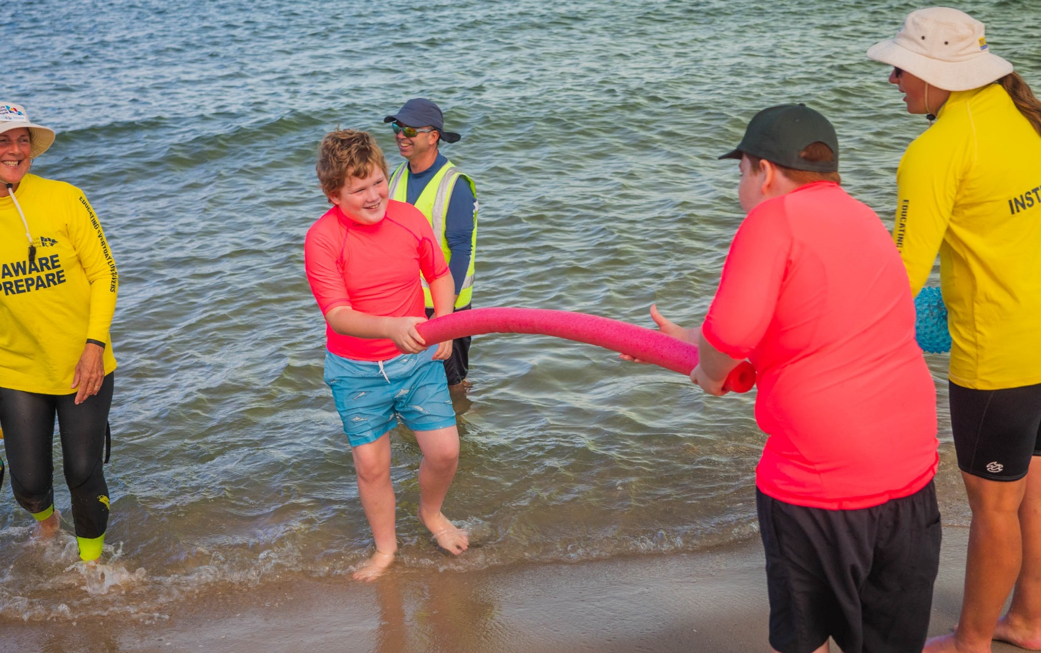
We will practise rescuing each other

Slide 23
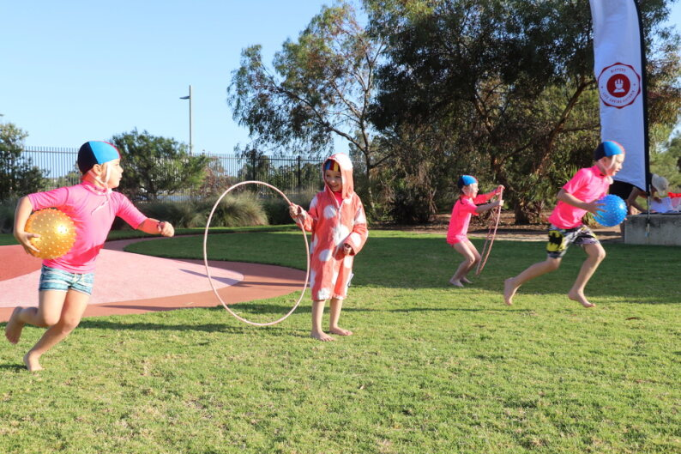
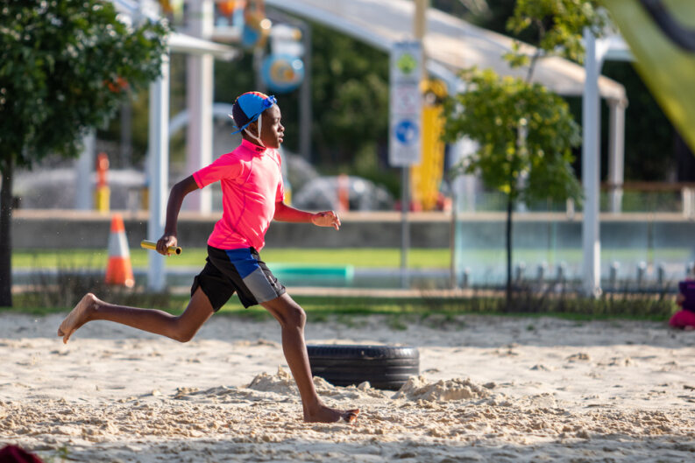
We will practice running, playing games and racing

Slide 24
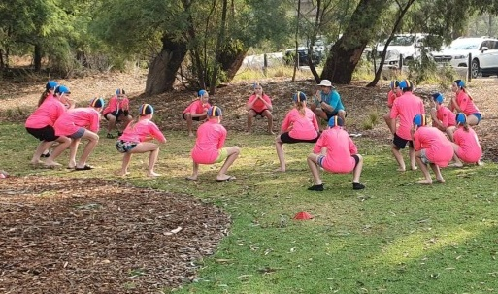
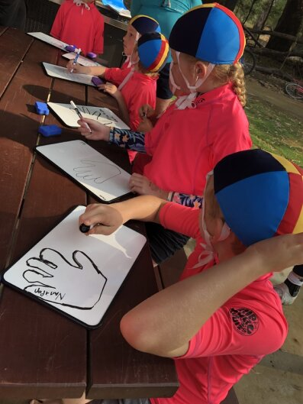
We will talk about ways to help us be healthy, and do some activities that keep us active

Slide 25
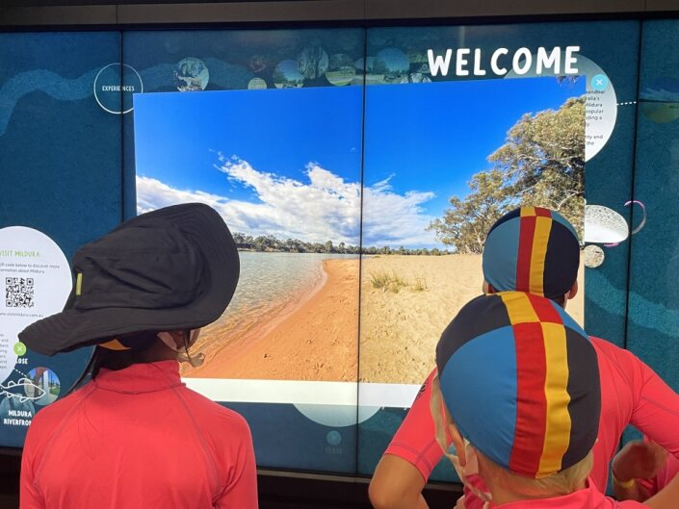
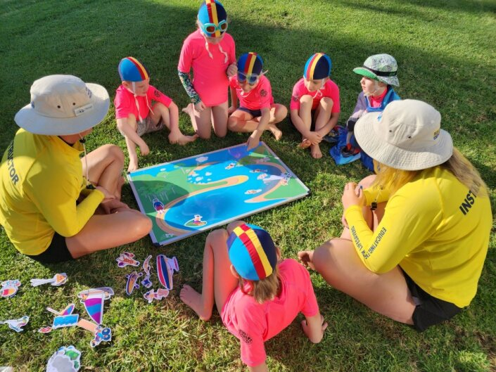
We will talk about caring for our waterways so that everyone can enjoy them

Slide 26
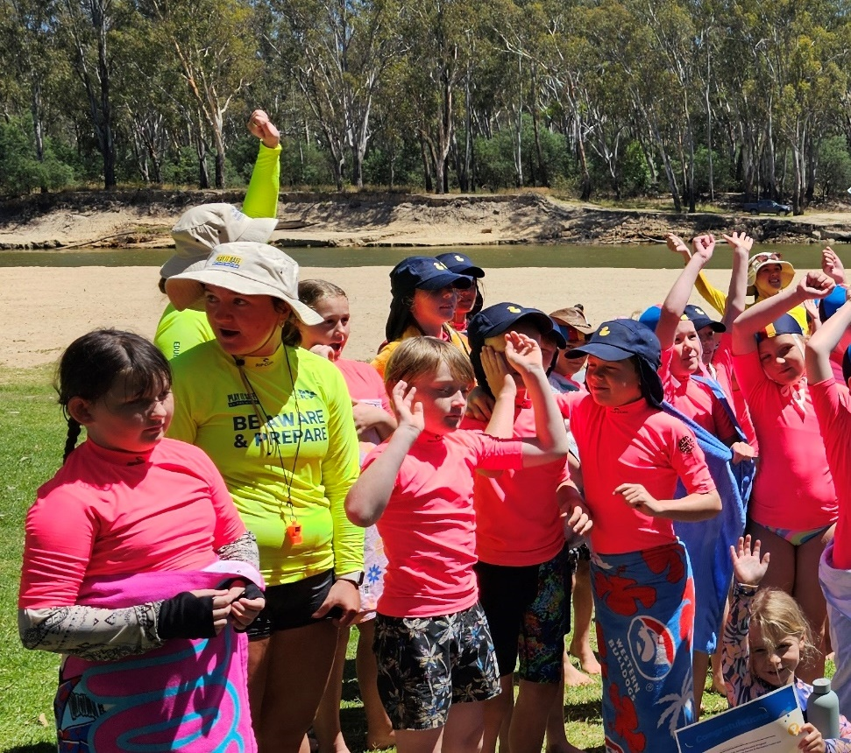
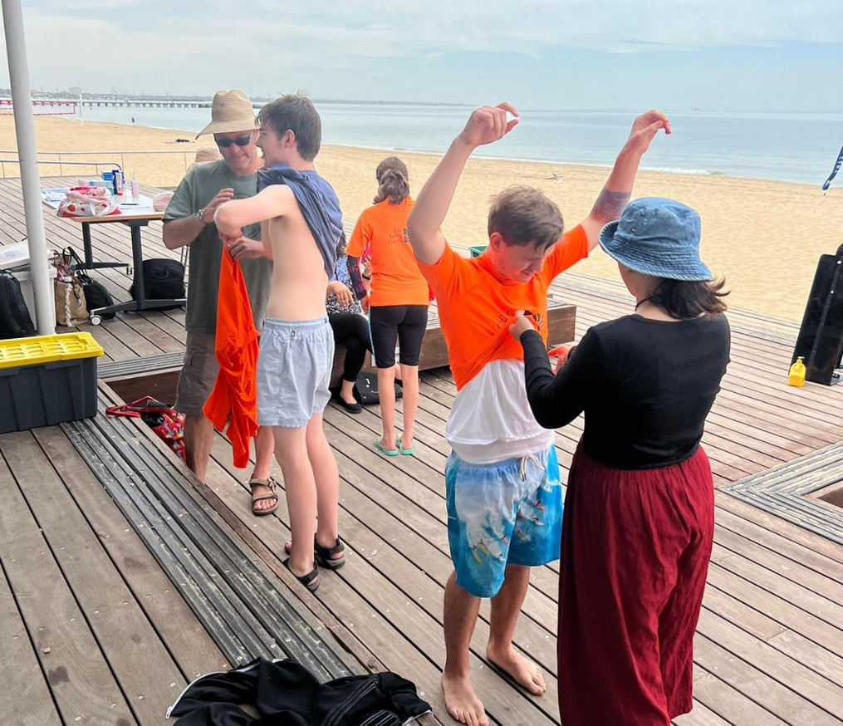
When the program ends, we will say goodbye

Slide 27
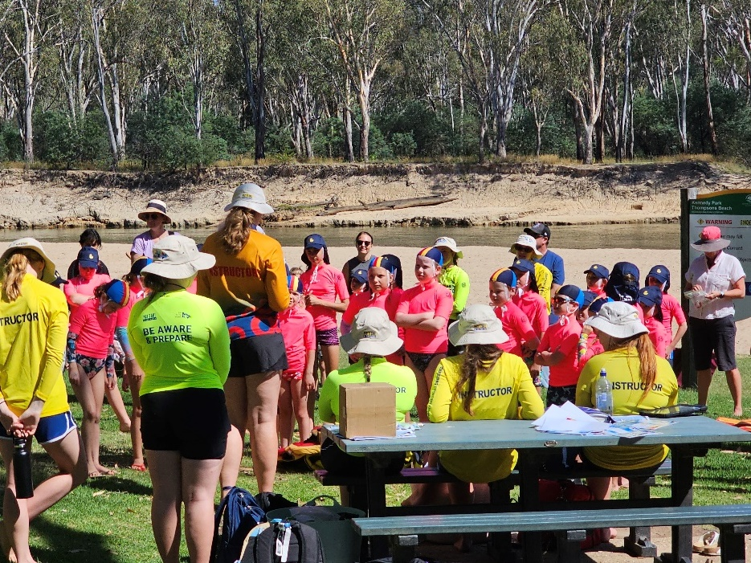
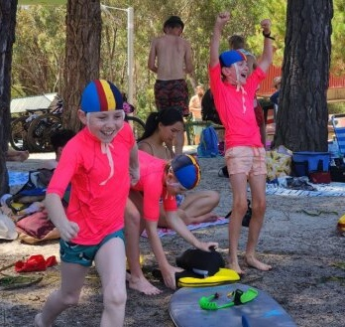
We will be coming back each morning for five days and joining our group

Slide 28
Some activities we will do two or three days, some activities we will do only one day.

Slide 29
On the last day we receive our certificate. When the program ends, we will say goodbye.

