Slide 1
Social Story – LEP School Programs
A social story can help students, especially autistic students, with expectations for participating in your program including what to bring, what they'll be doing and who will be with them. This can assist to lower anxiety about participating in something new. This should be shared in PowerPoint format to ensure schools can adapt to their students' needs.
Instructions:
Update relevant sections based on your school offering – select ‘show comments’ to see LSV’s suggestions. Drag and drop images or replace with your own relevant images wherever possible to ensure accurate representations are shared with students. Delete any unused images.
Update any highlighted text and remove highlighting. Delete this slide before sharing. Delete comments directed to ‘Partners’ before sharing.

Slide 2
Social Story – LEP School Programs
LSV and ** have developed this Social Story to use ahead of your school’s Lifesaving education program for any student that may benefit. A social story can help students, especially autistic students, with expectations for participating in your program including what to bring, what they'll be doing and who will be with them. This can assist to lower anxiety about participating in something new.
Please review against your proposed program and update as required – i.e., select ‘see comments’ to check activities against your selected program type, or you may have elected to participate in some activities and not others, you may also like to add in other aspects about which room you will be in and which school staff will be available.

Slide 3
Social story: What happens in a Lifesaving education program – in the classroom
Lifesaving Education Programs

Slide 4
Read this social story before and after participating in the Lifesaving education program- in the classroom.
We hope you have lots of fun trying the different activities.

Slide 5
Life Saving Victoria acknowledges the Traditional Owners of the land and water where we meet.
We pay our respects to Elders past, present and emerging.

Slide 6
XXXX
acknowledges the Traditional Owners of the land and water where we deliver the Lifesaving education programs, the XXXX.
We pay our respects to Elders past, present and emerging.

Slide 7
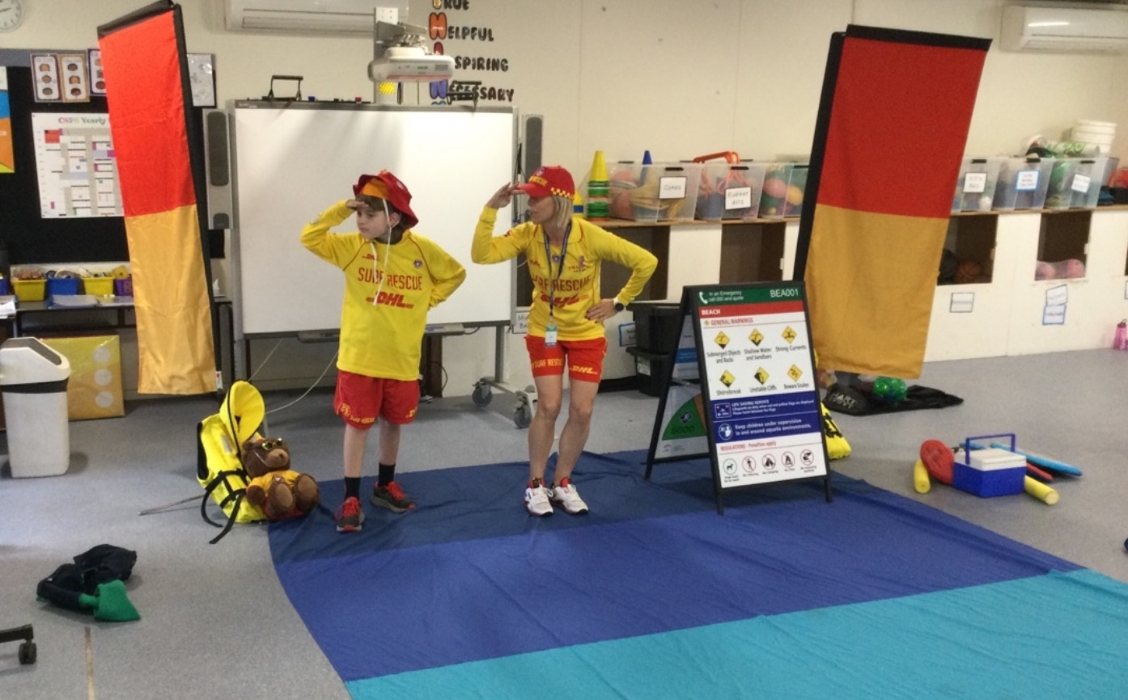
We arrive at XX room at school

Slide 8
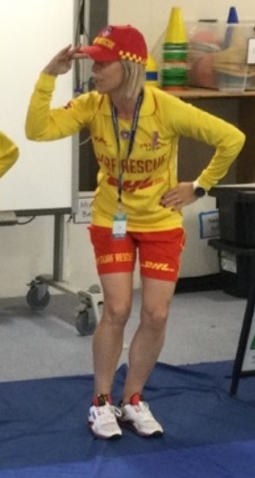
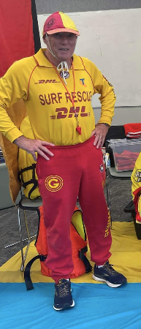
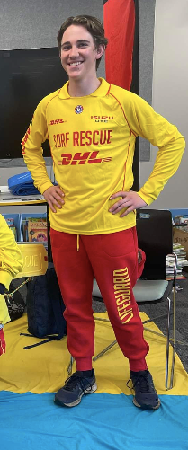
We meet the lifeguard/s, and these are their uniforms

Slide 9
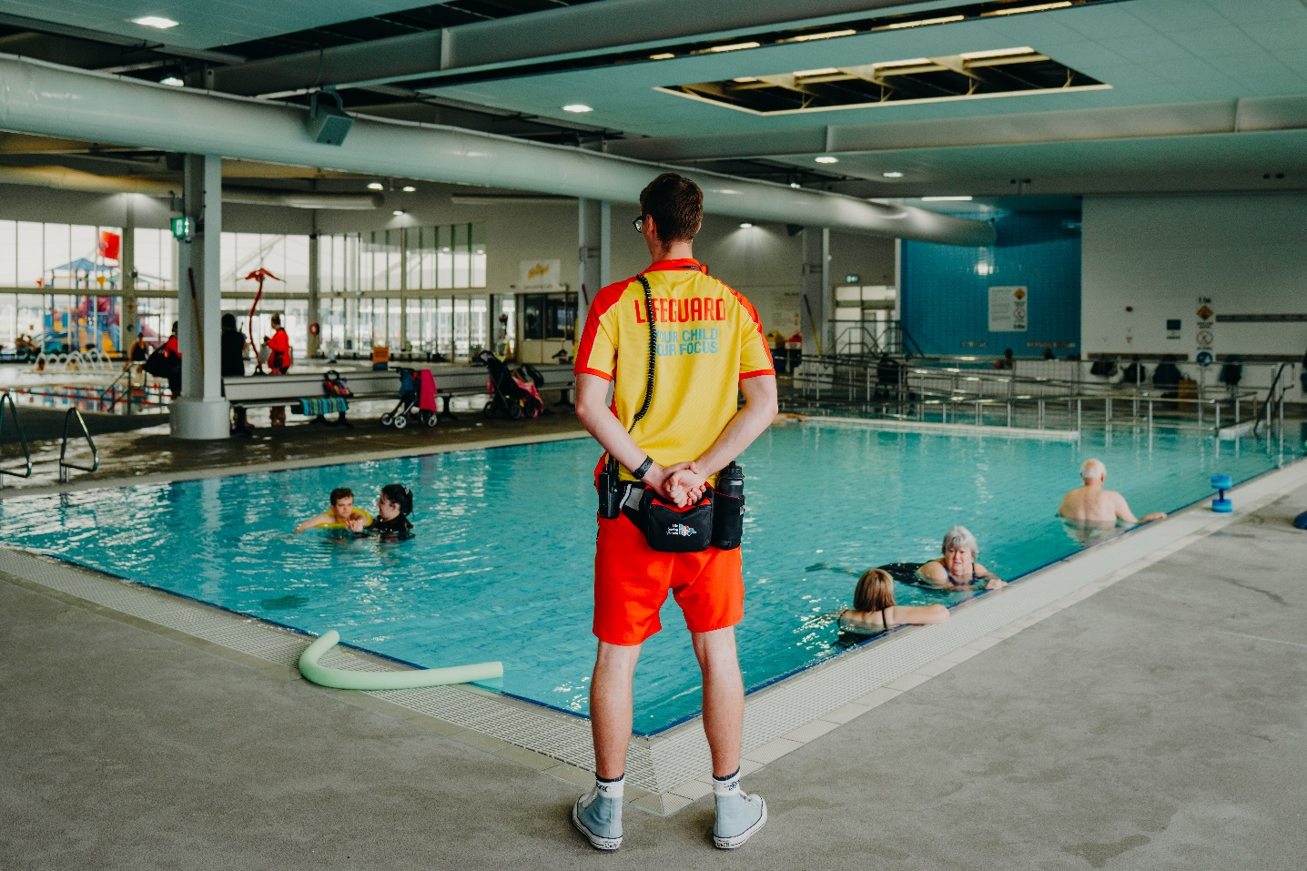
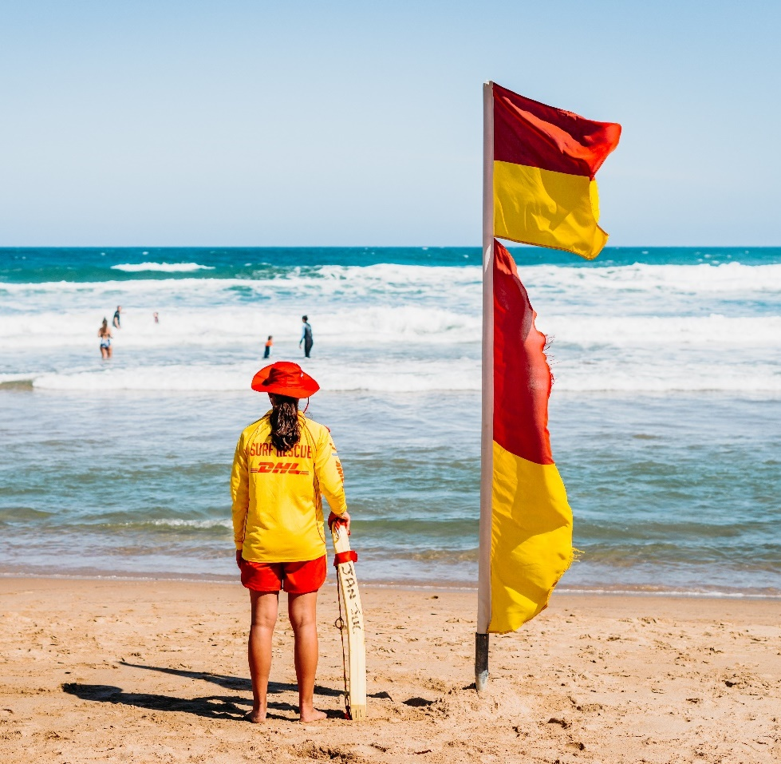
We learn about what a lifeguard is

Slide 10
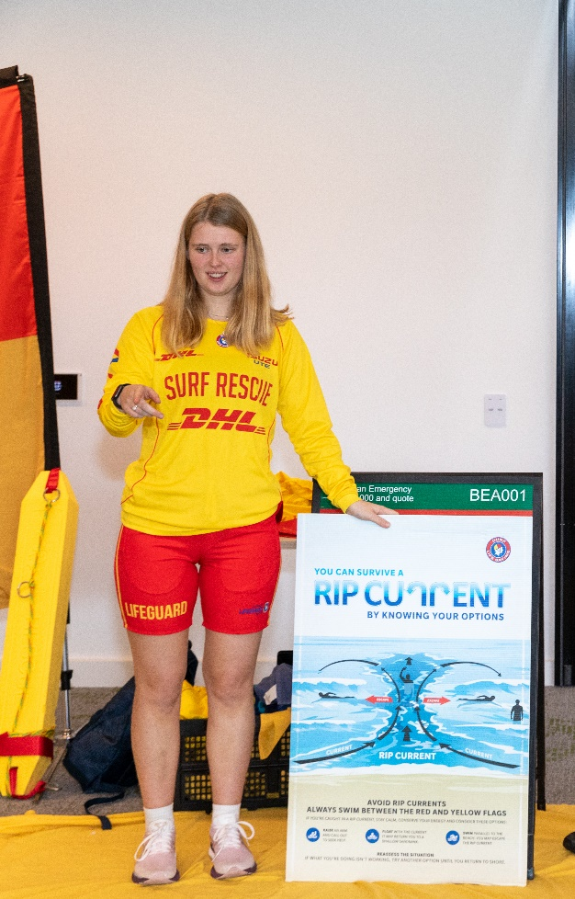
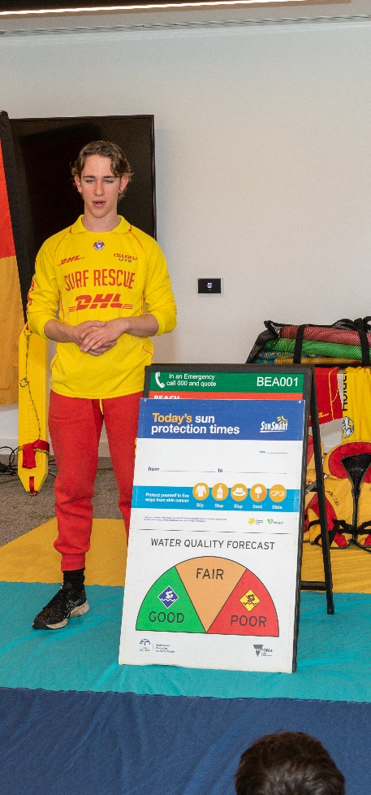
Activities might include learning about currents and other dangers near water

Slide 11
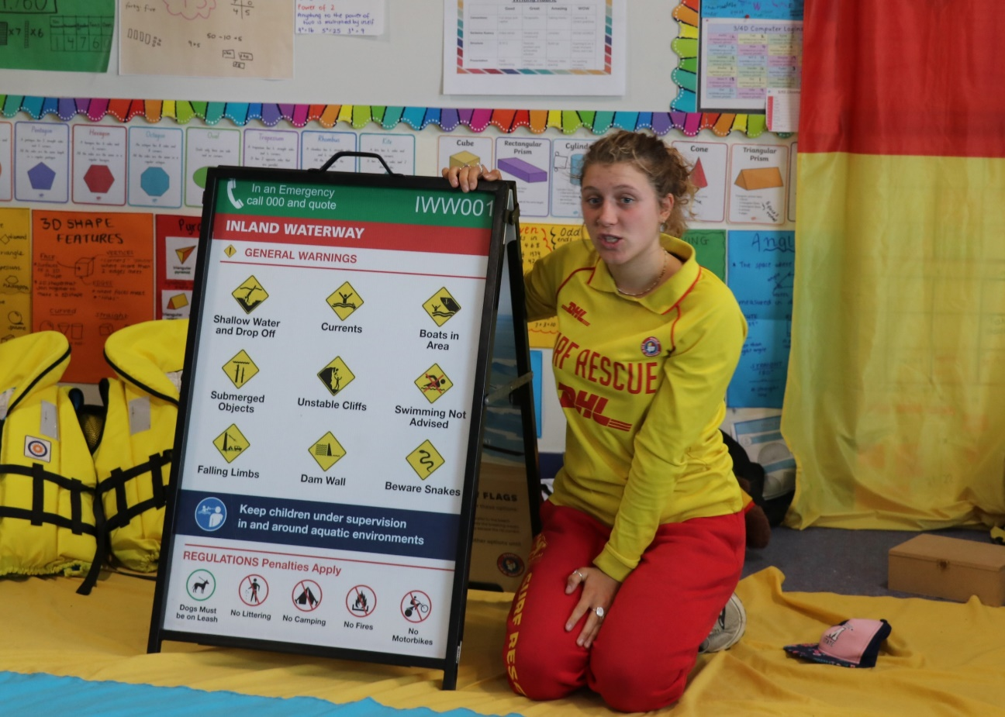
Activities might include learning about safety signs

Slide 12
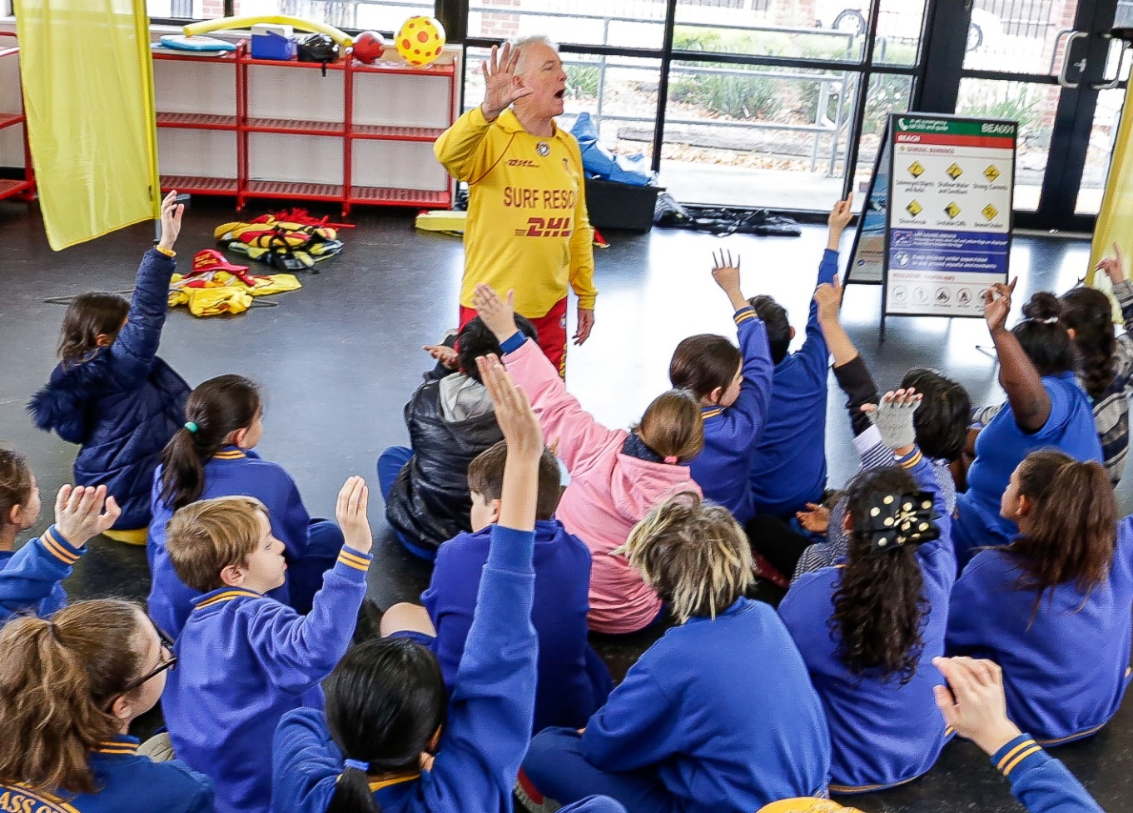
We can practice calling for help

Slide 13
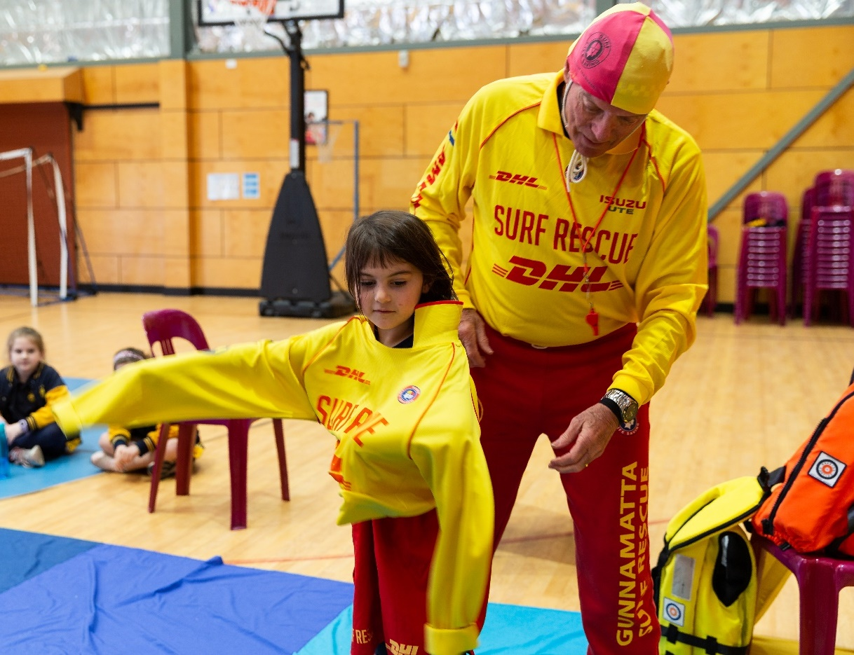
Activities might include dressing-up as a lifeguard

Slide 14
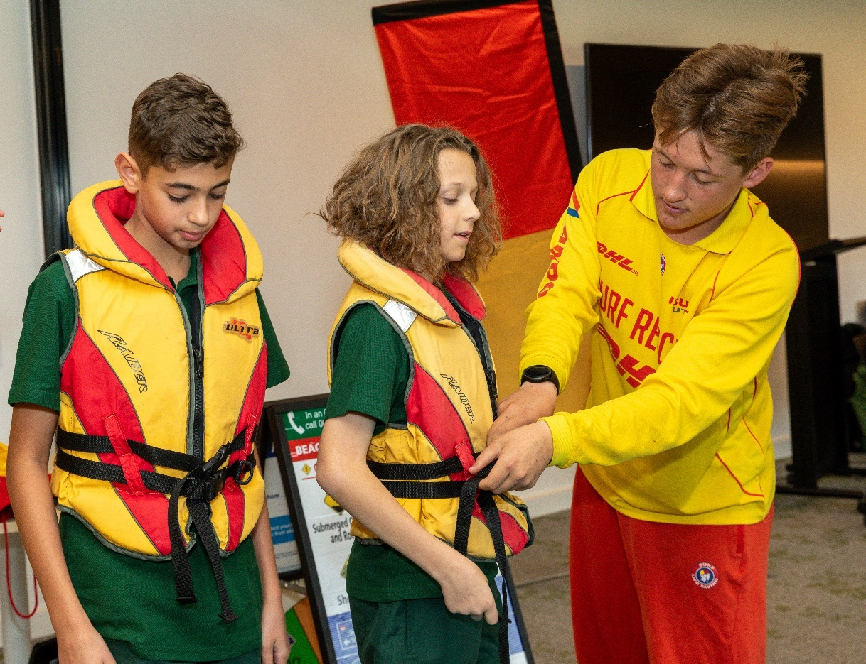
Activities might include trying on a lifejacket

Slide 15
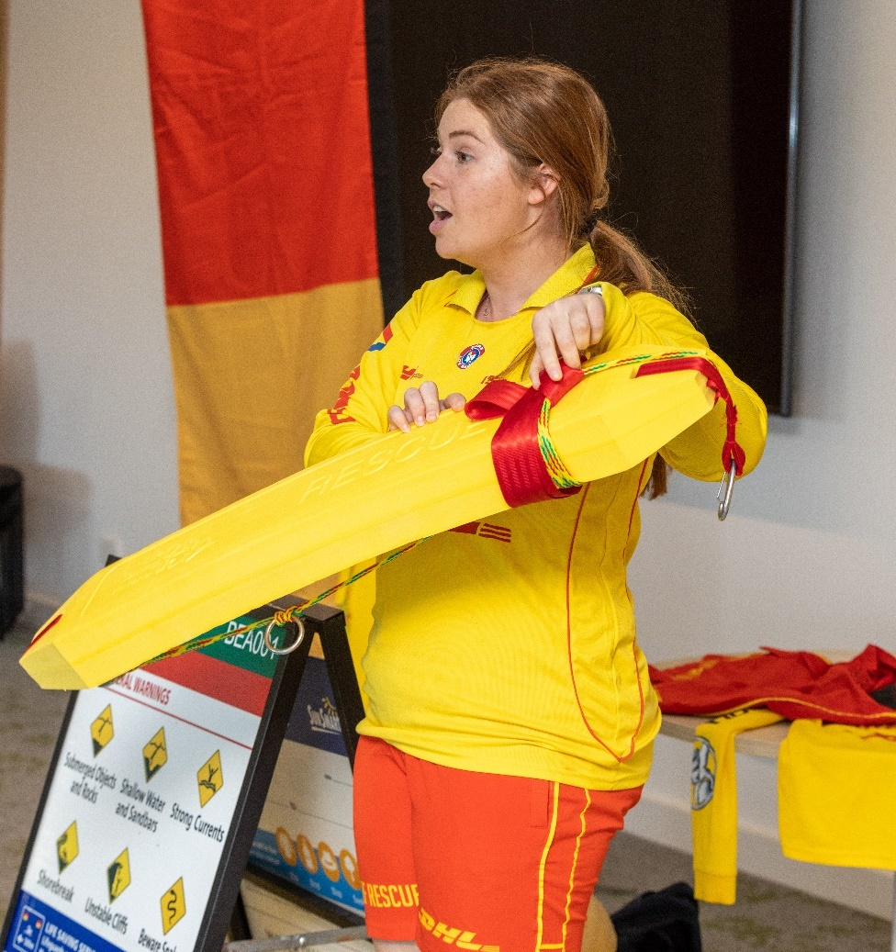
Activities might include watching a pretend rescue

Slide 16
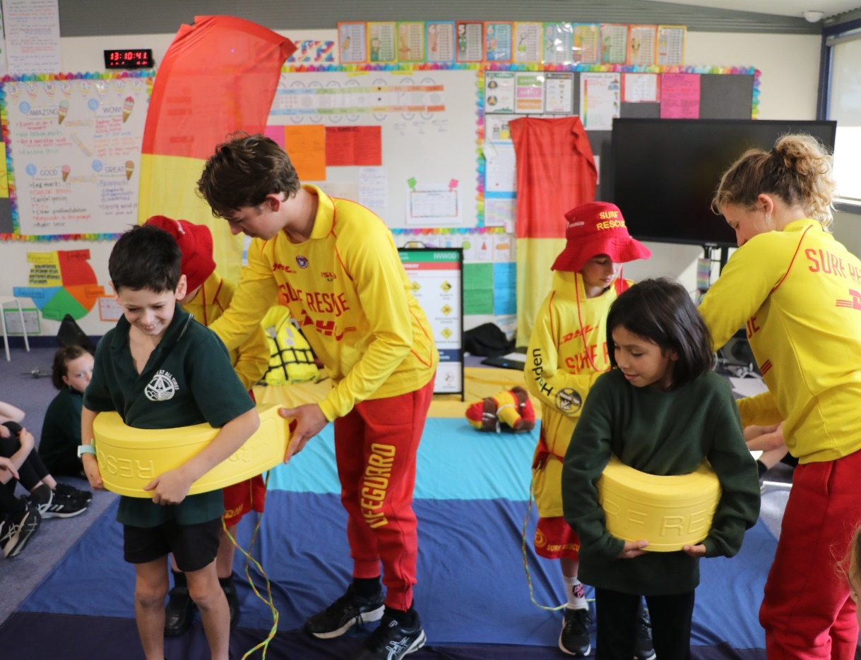
Activities might include practicing being rescued

Slide 17
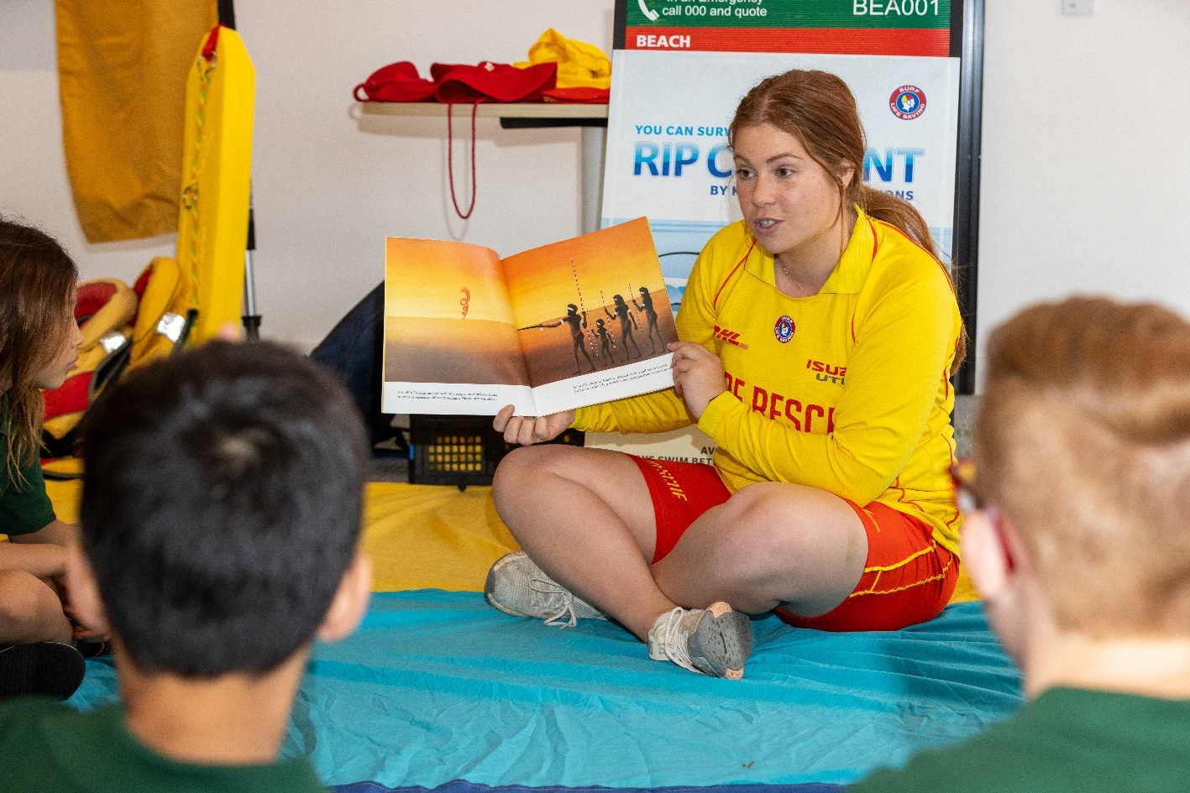
Activities might include reading or hearing a story

Slide 18
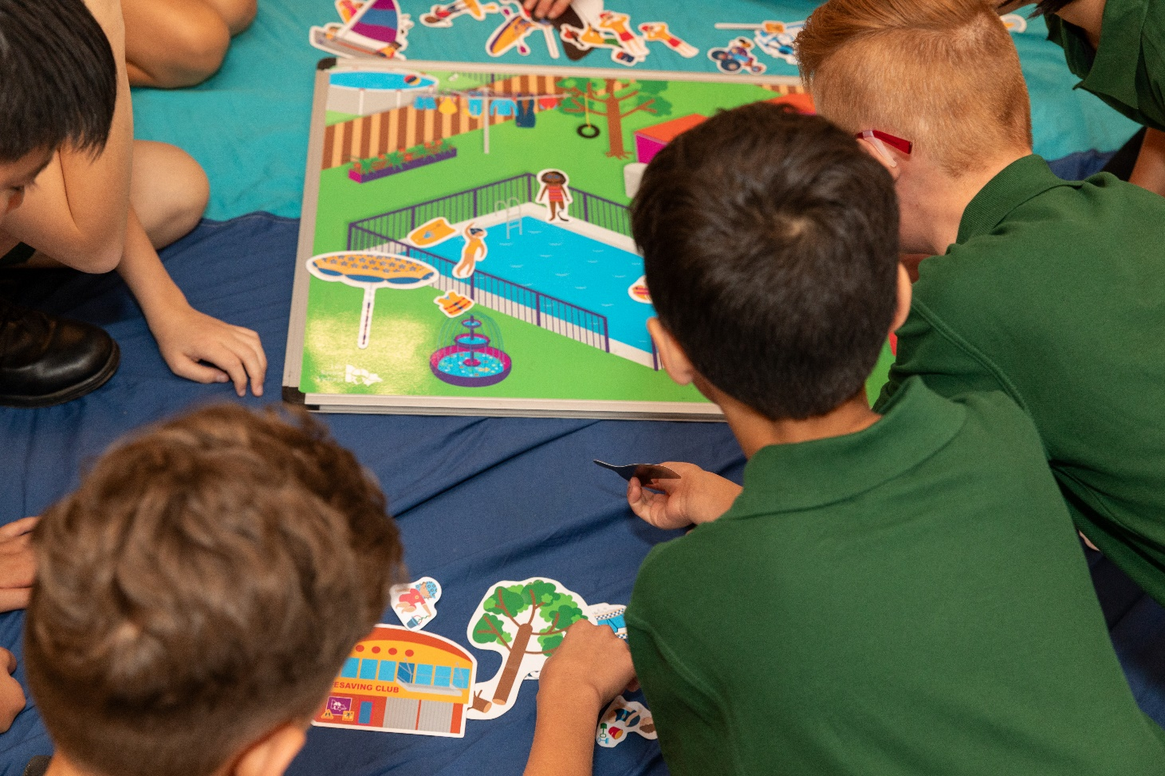
Activities might include playing magnet board and magnets

Slide 19
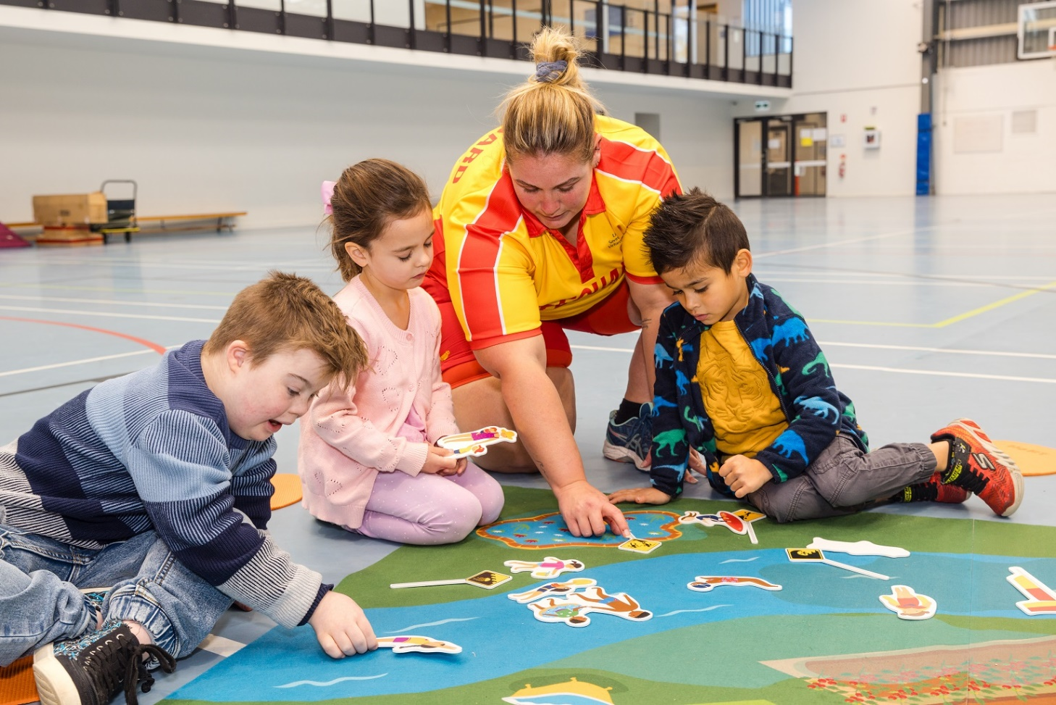
Activities might include playing with the LSV toys on the carpet mat

Slide 20
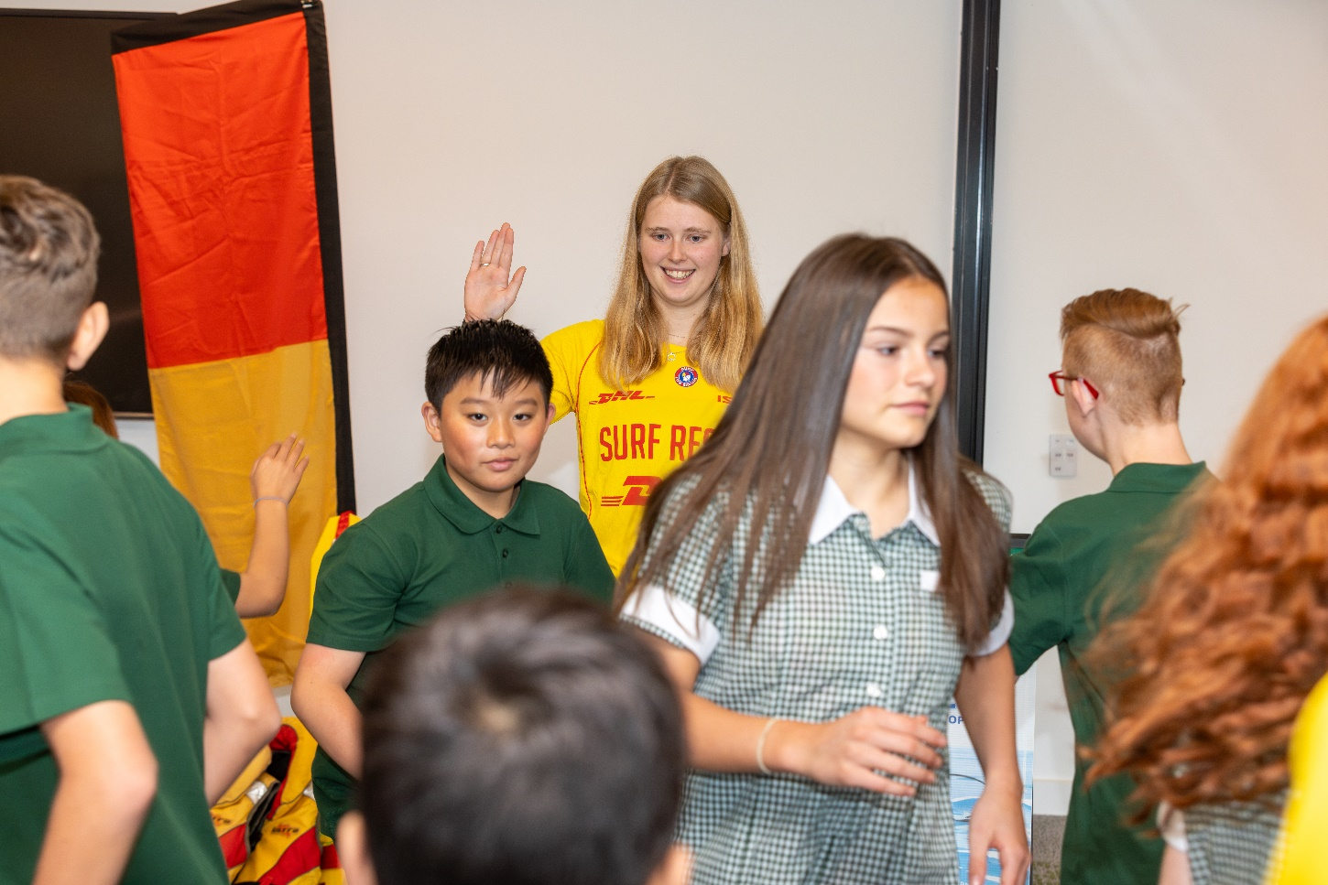
Now the program ends, and we say goodbye

